Slide 1
AEDS 6400: Computational Methods for Economists
Class 1: Introduction

Slide 2
Causal Questions in Business
Class Outline
Syllabus
R Crash Course
Creating and Connecting a GitHub Repository in RStudio
Setting Up a Quarto Website
”Homework 0”

Slide 3
Causal Questions in Business
Creating & Connecting a GitHub Repo in RStudio
After downloading R and RStudio:
Next step: Create a GitHub account.
Git is a version control system that tracks changes to your files.
Instead of saving files as analysis_final_v2.R, analysis_final_v3.R, analysis_FINAL_really_final.R, Git records the complete history of changes and lets you return to any previous version.
GitHub stores your Git repositories online.
This makes it easy to back up your work, collaborate with others, and access your projects from different computers.

Slide 4
Causal Questions in Business
Creating & Connecting a GitHub Repo in RStudio
Step 1: Creating a GitHub Repository
Create a Repository
Log in/create account to GitHub.
Click New Repository.
Choose a repository name (e.g., myrepo).
Make it Public.
Initialize with a README.
Click Create Repository.

Slide 5
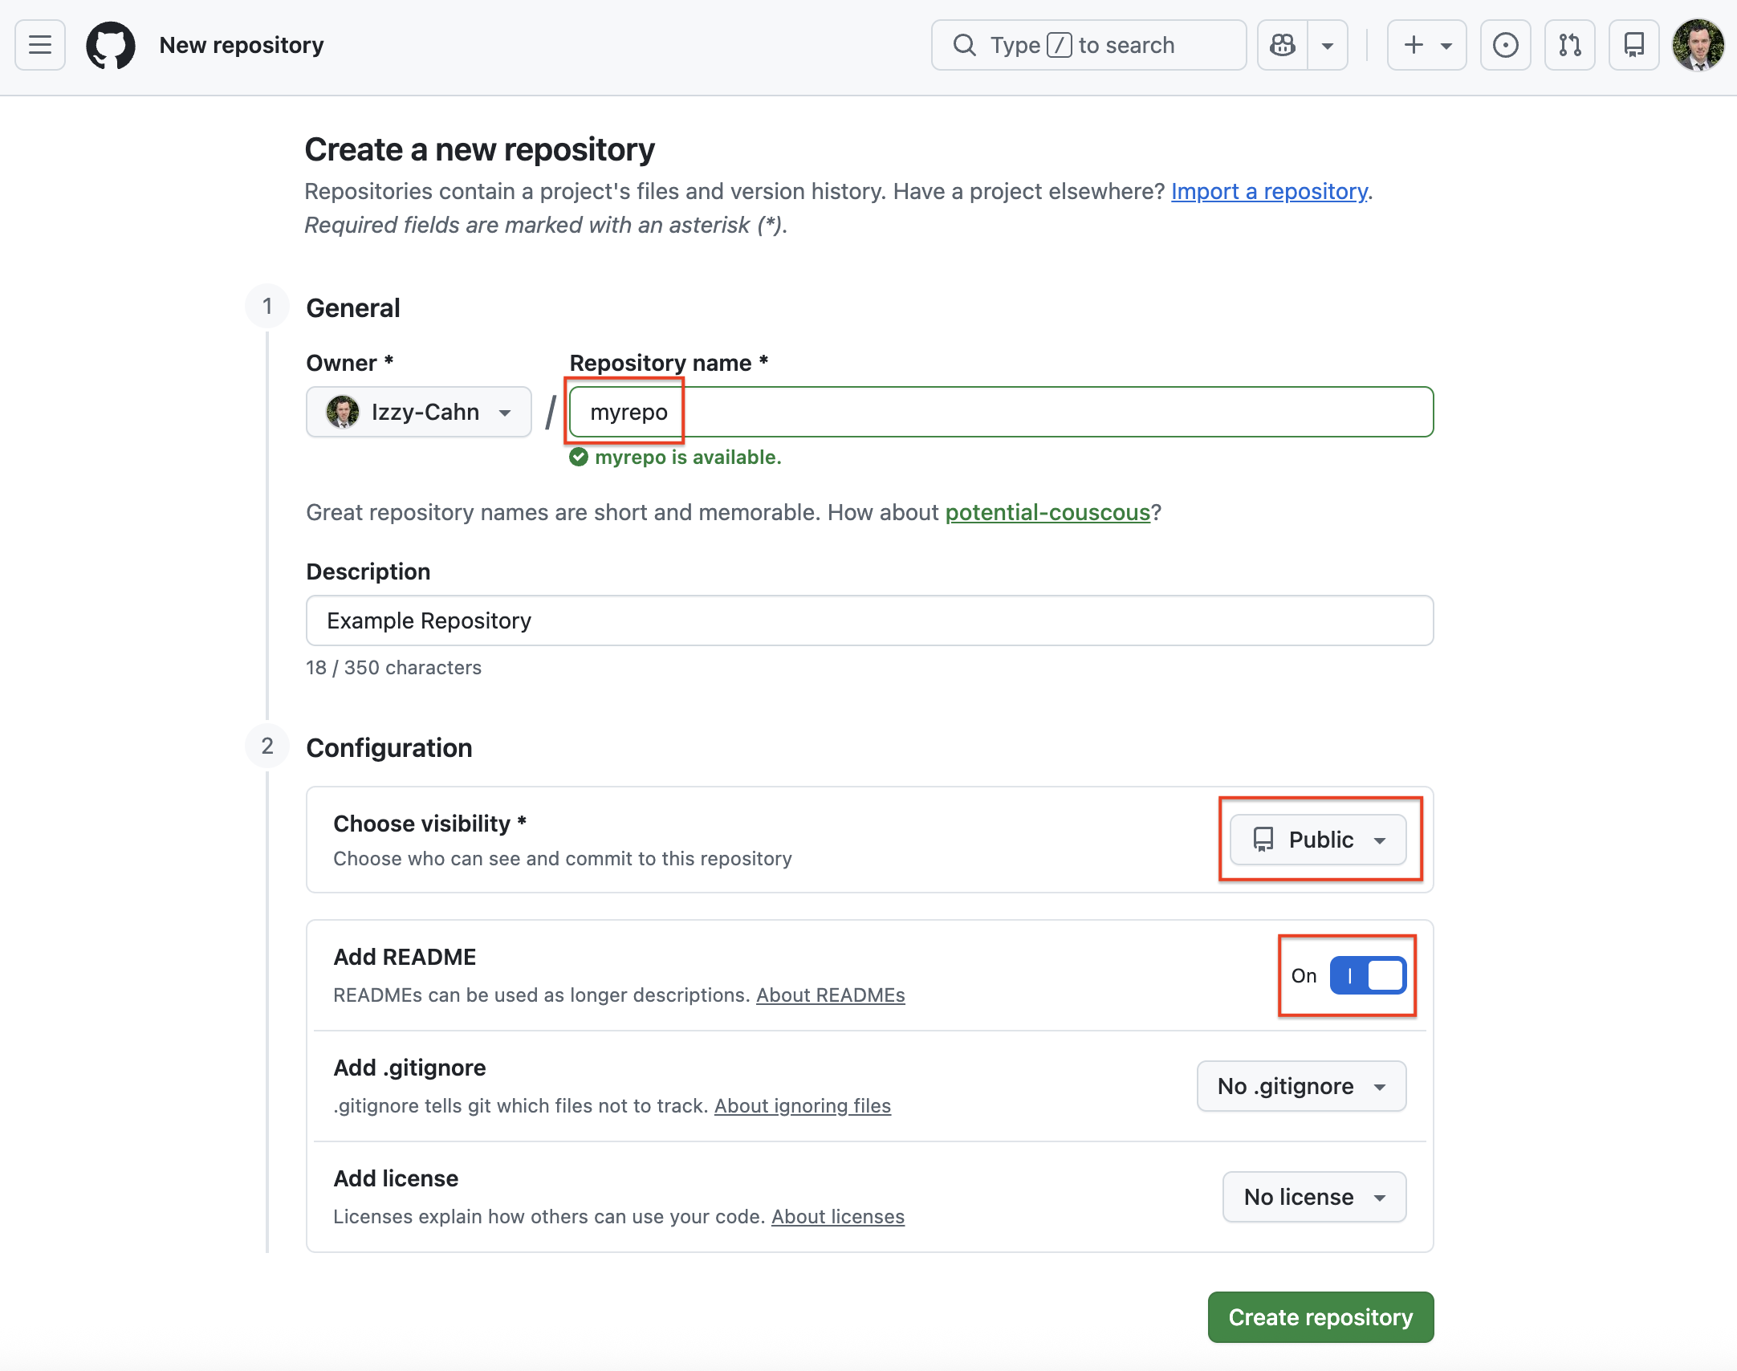
Causal Questions in Business
Creating & Connecting a GitHub Repo in RStudio

Slide 6
Causal Questions in Business
Creating & Connecting a GitHub Repo in RStudio
Step 2: Clone the Repository
In RStudio:
File → New Project
Version Control
Git
Paste the repository URL.
Choose a local folder.
Click Create Project.

Slide 7
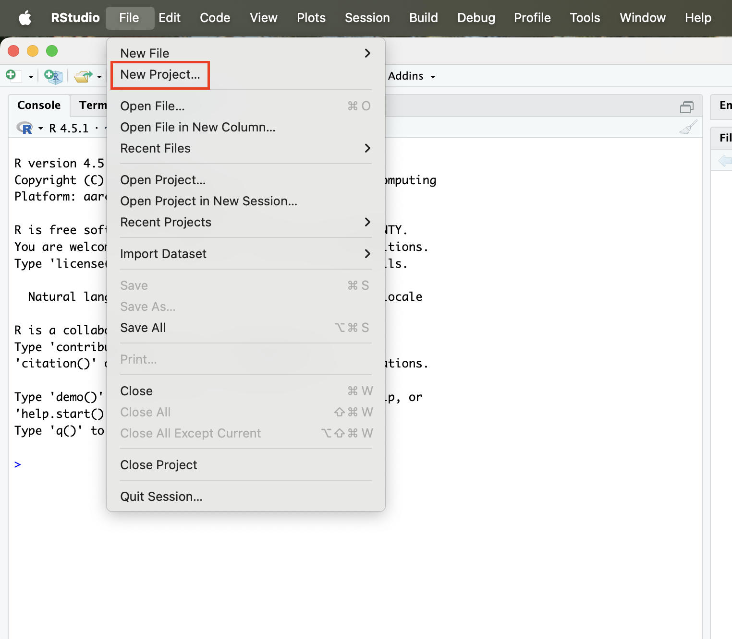
Causal Questions in Business
Creating & Connecting a GitHub Repo in RStudio

Slide 8
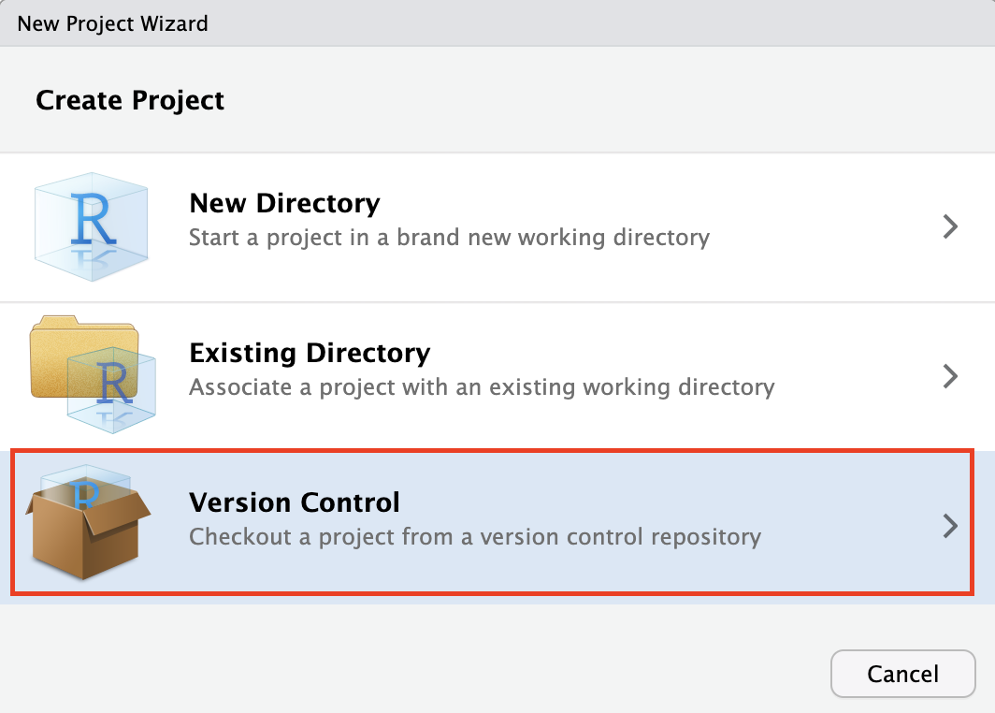
Causal Questions in Business
Creating & Connecting a GitHub Repo in RStudio

Slide 9
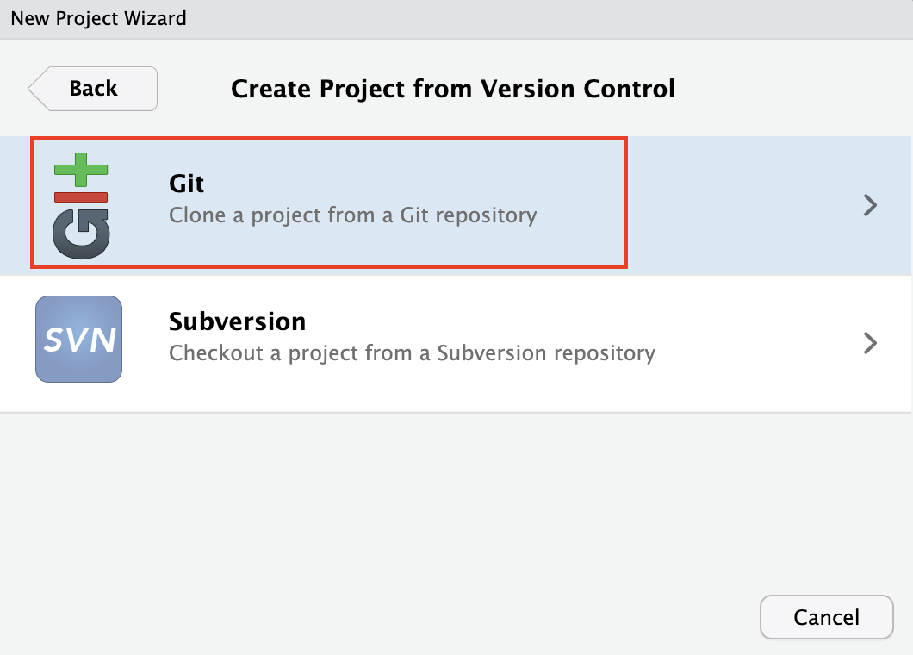
Causal Questions in Business
Creating & Connecting a GitHub Repo in RStudio

Slide 10
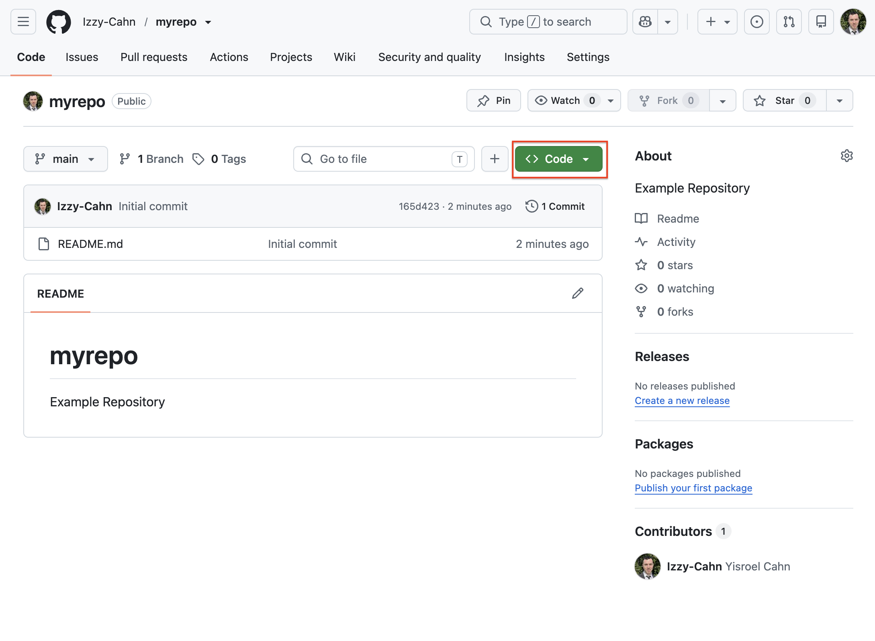
Creating & Connecting a GitHub Repo in RStudio
4. Paste the repository URL:

Slide 11
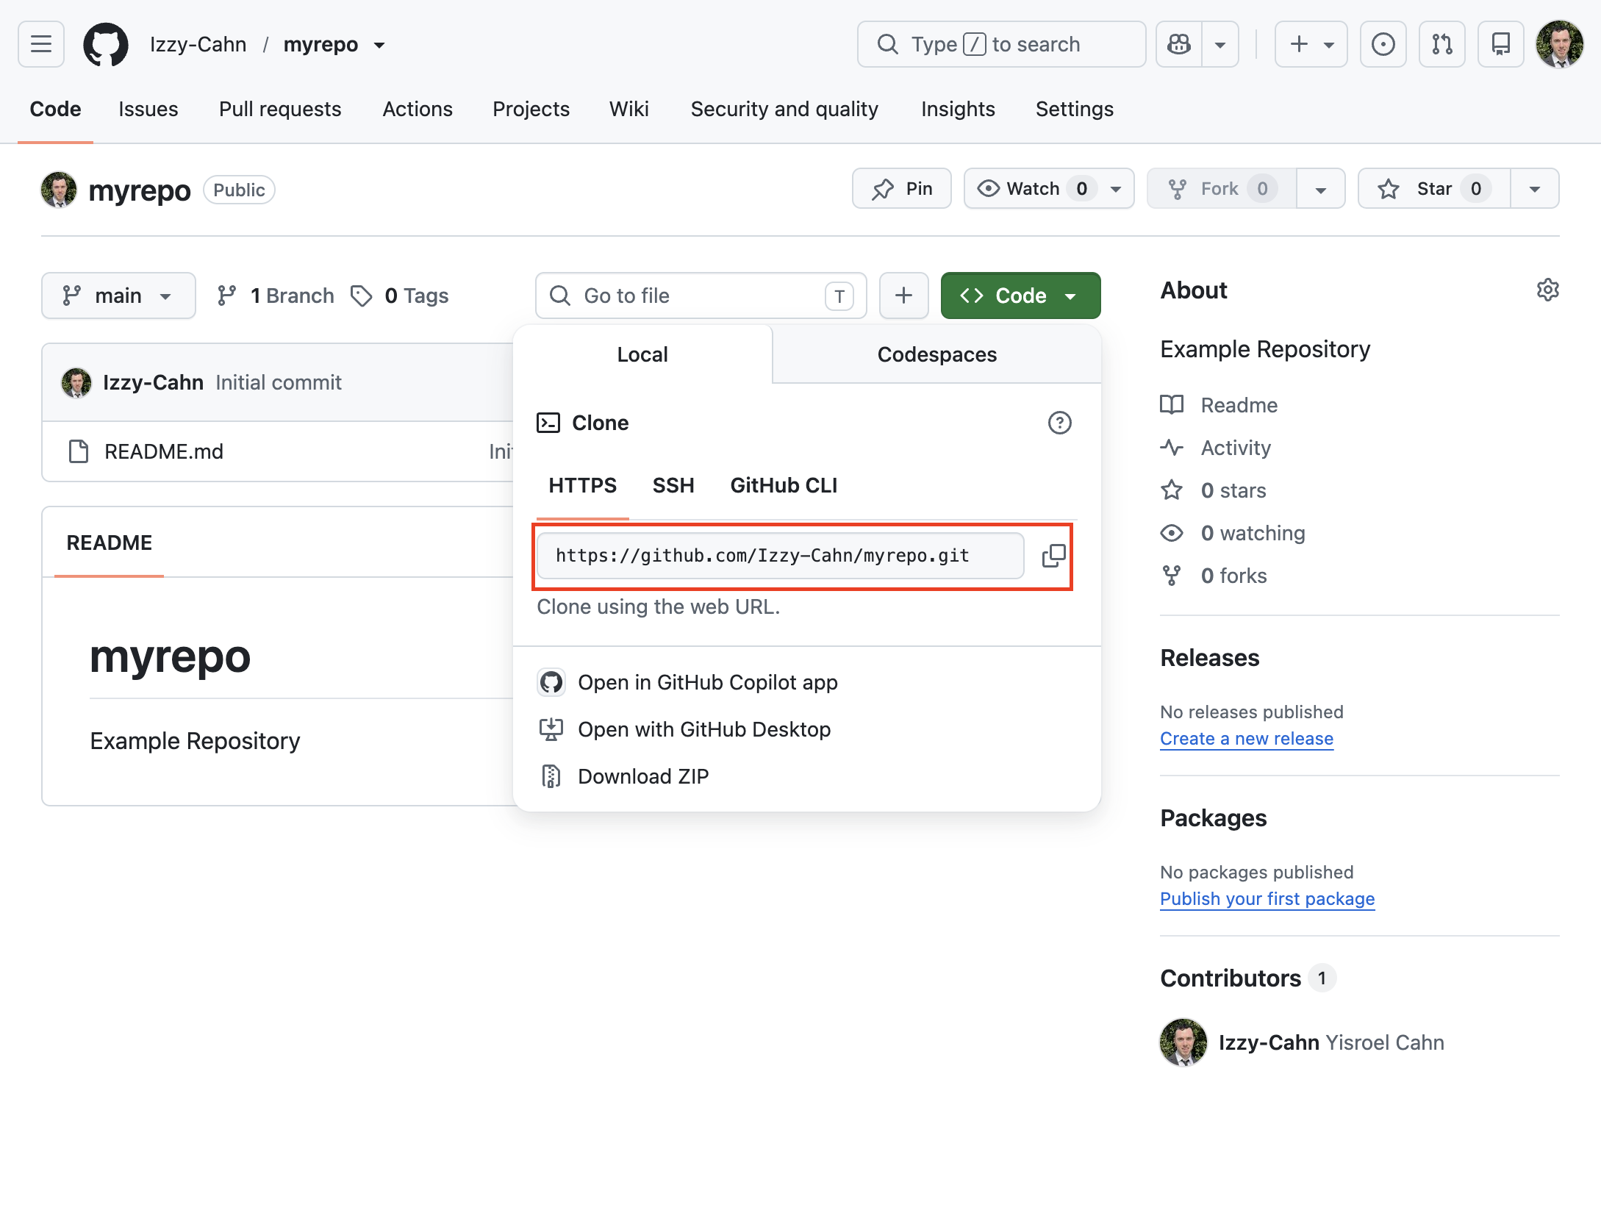
Creating & Connecting a GitHub Repo in RStudio
4. Paste the repository URL:

Slide 12
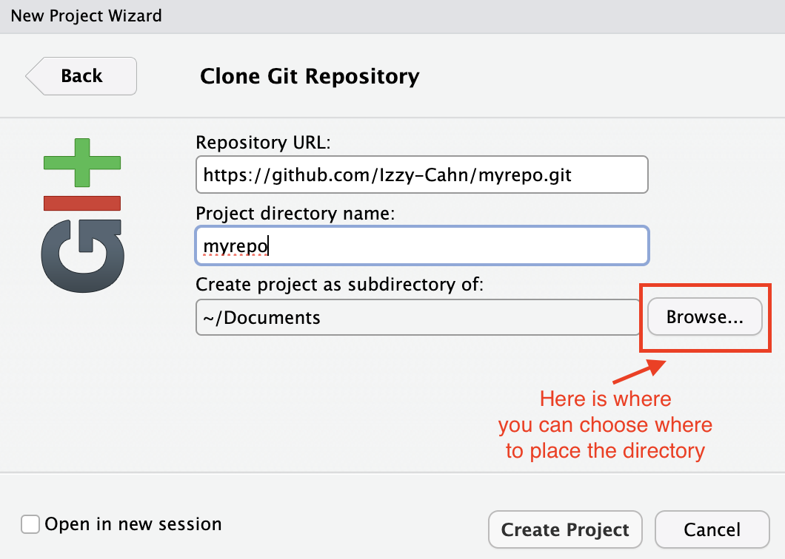
Creating & Connecting a GitHub Repo in RStudio

Slide 13
Causal Questions in Business
Creating & Connecting a GitHub Repo in RStudio
Step 3: Authenticate (First Time Only)
Create a Personal Access Token (PAT)
On GitHub, click your profile picture → Settings.
Go to Developer settings.
Select Personal access tokens.
Choose Tokens (classic)
Click Generate new token.
Give it a name and an expiration date.
Grant the repo permission (or equivalent repository access for a fine-grained token).
Generate the token and copy it immediately (GitHub won't show it again).
When Git asks for your password:
Username: your GitHub username
Password: paste the Personal Access Token

Slide 14
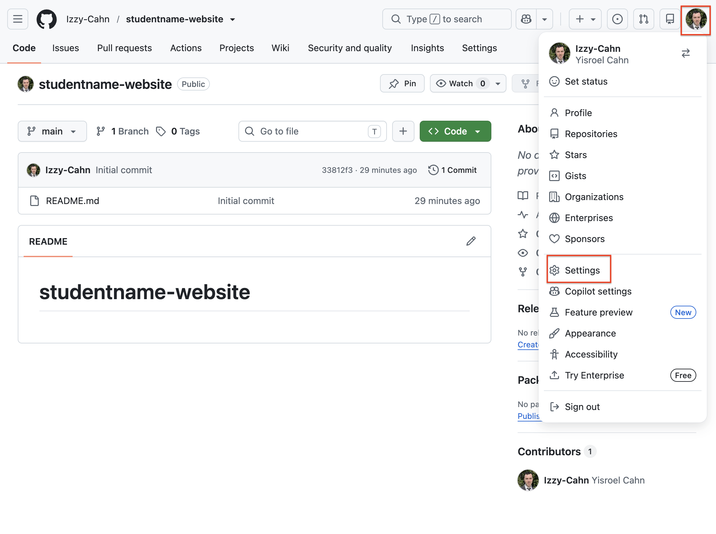
Causal Questions in Business
Creating & Connecting a GitHub Repo in RStudio

Slide 15
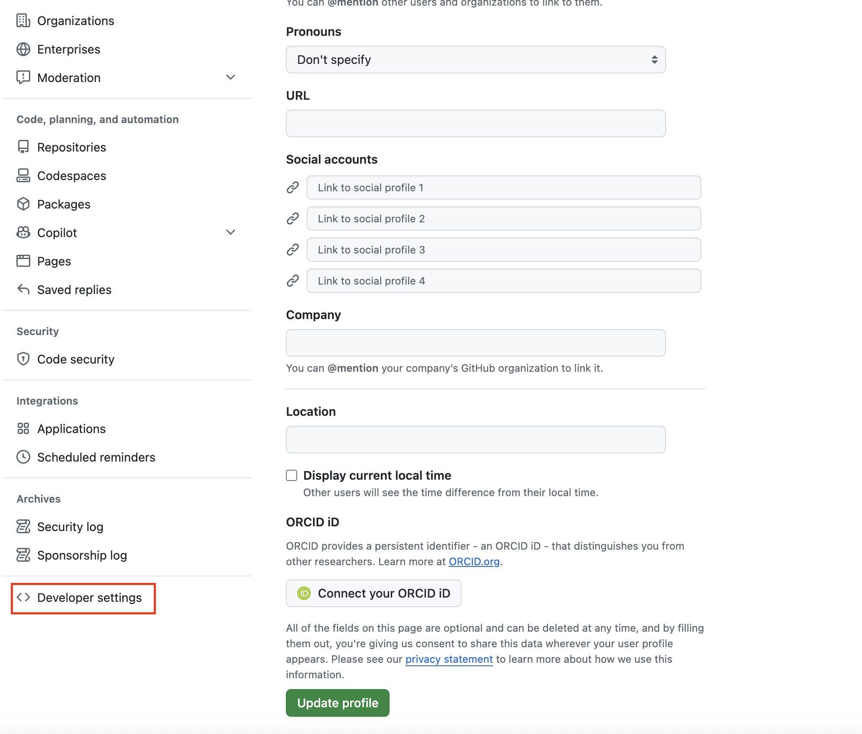
Causal Questions in Business
Creating & Connecting a GitHub Repo in RStudio

Slide 16
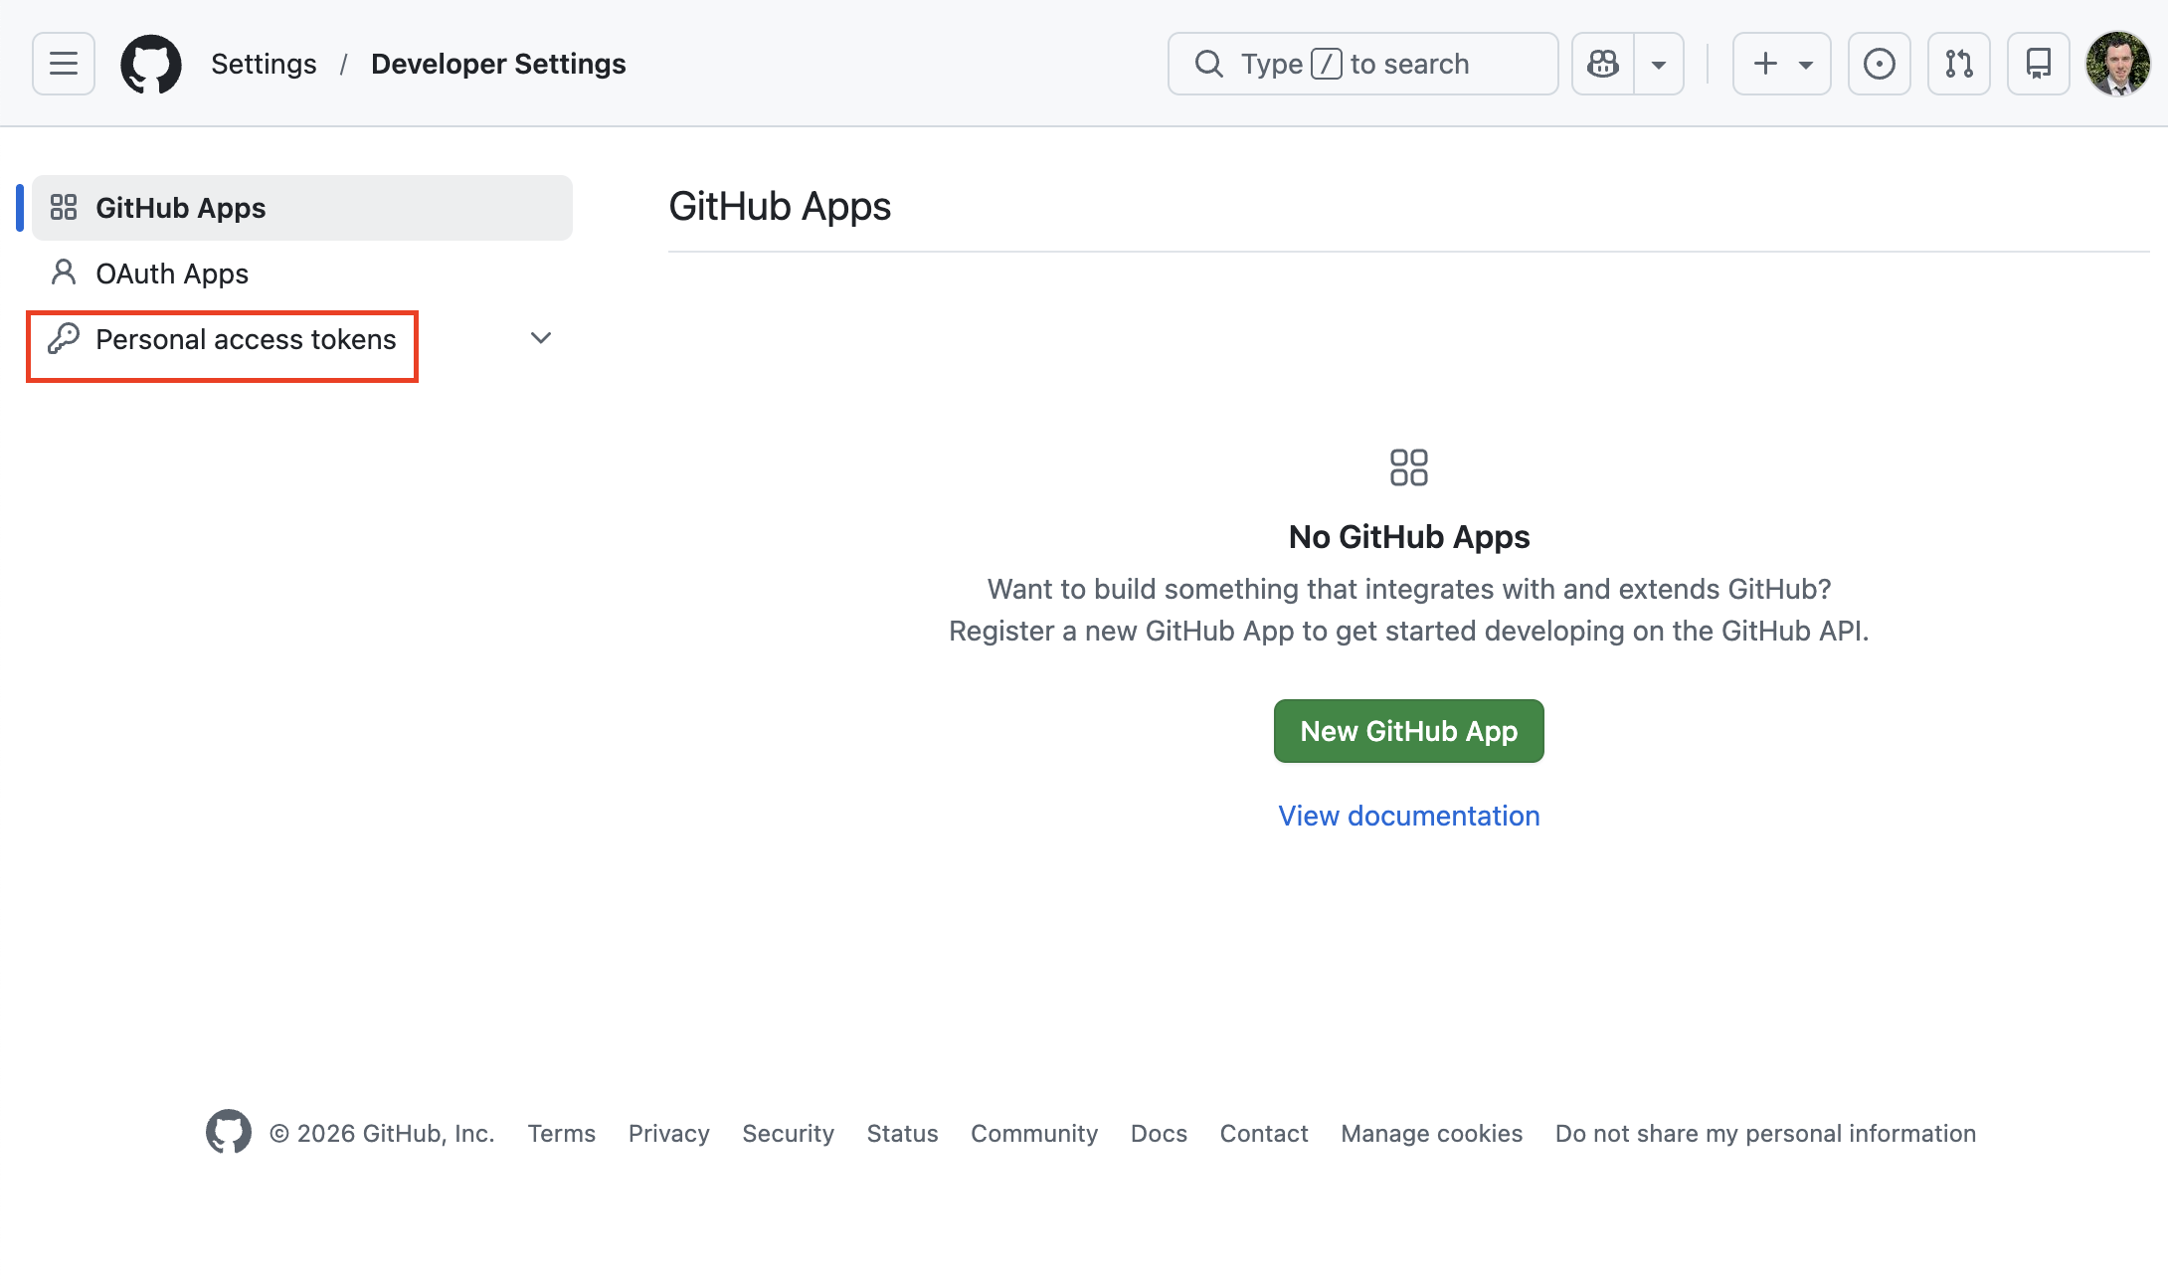
Causal Questions in Business
Creating & Connecting a GitHub Repo in RStudio

Slide 17
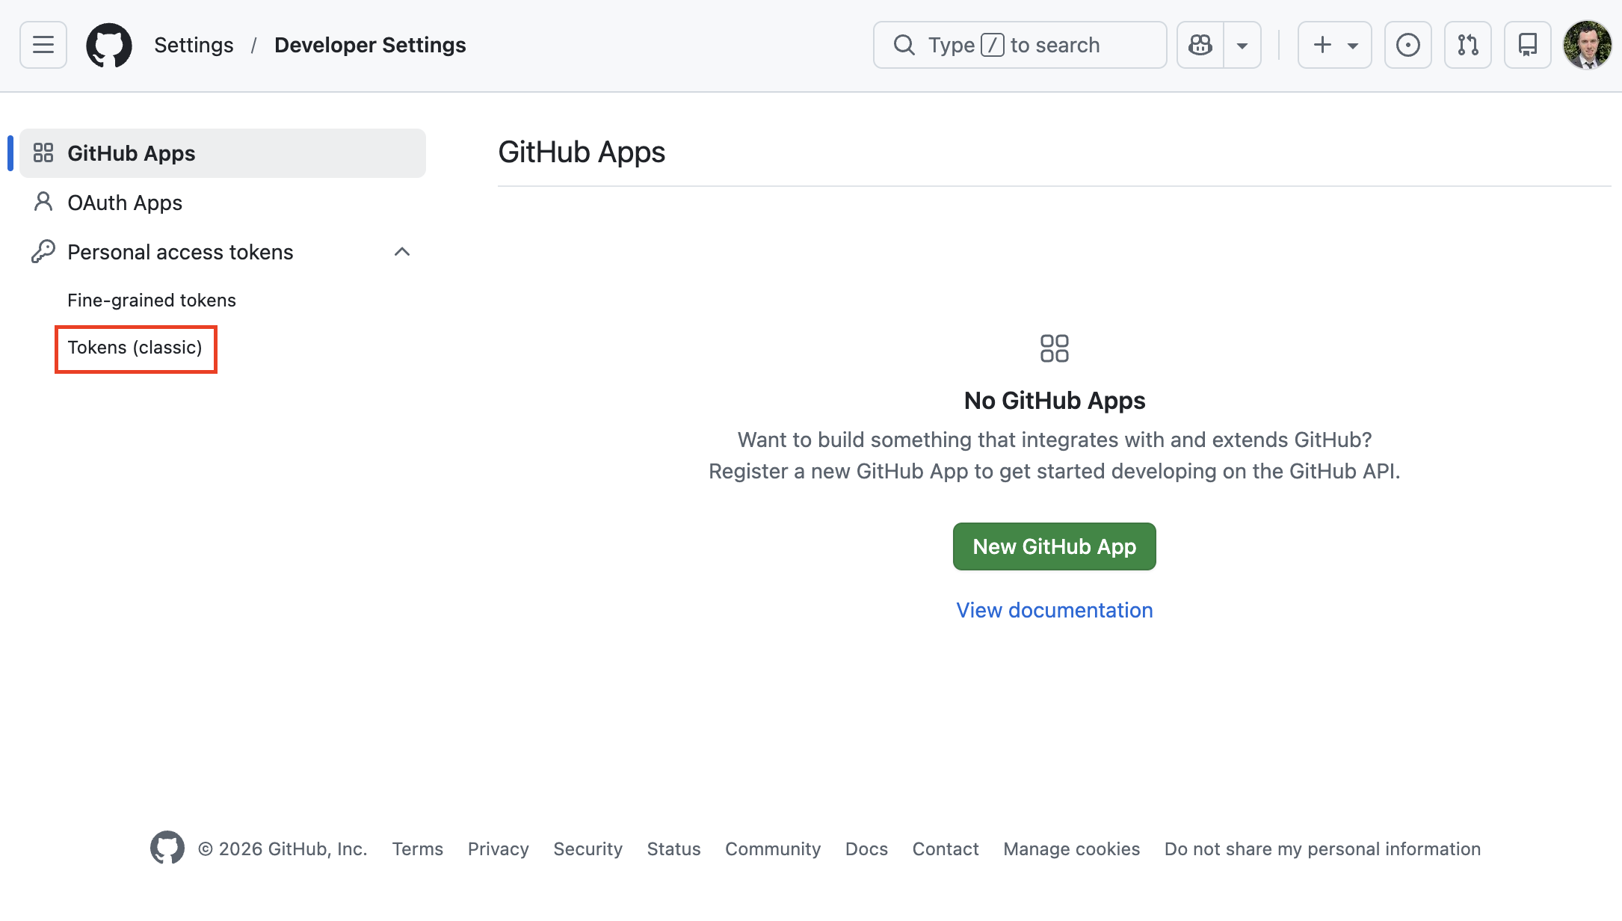
Causal Questions in Business
Creating & Connecting a GitHub Repo in RStudio

Slide 18
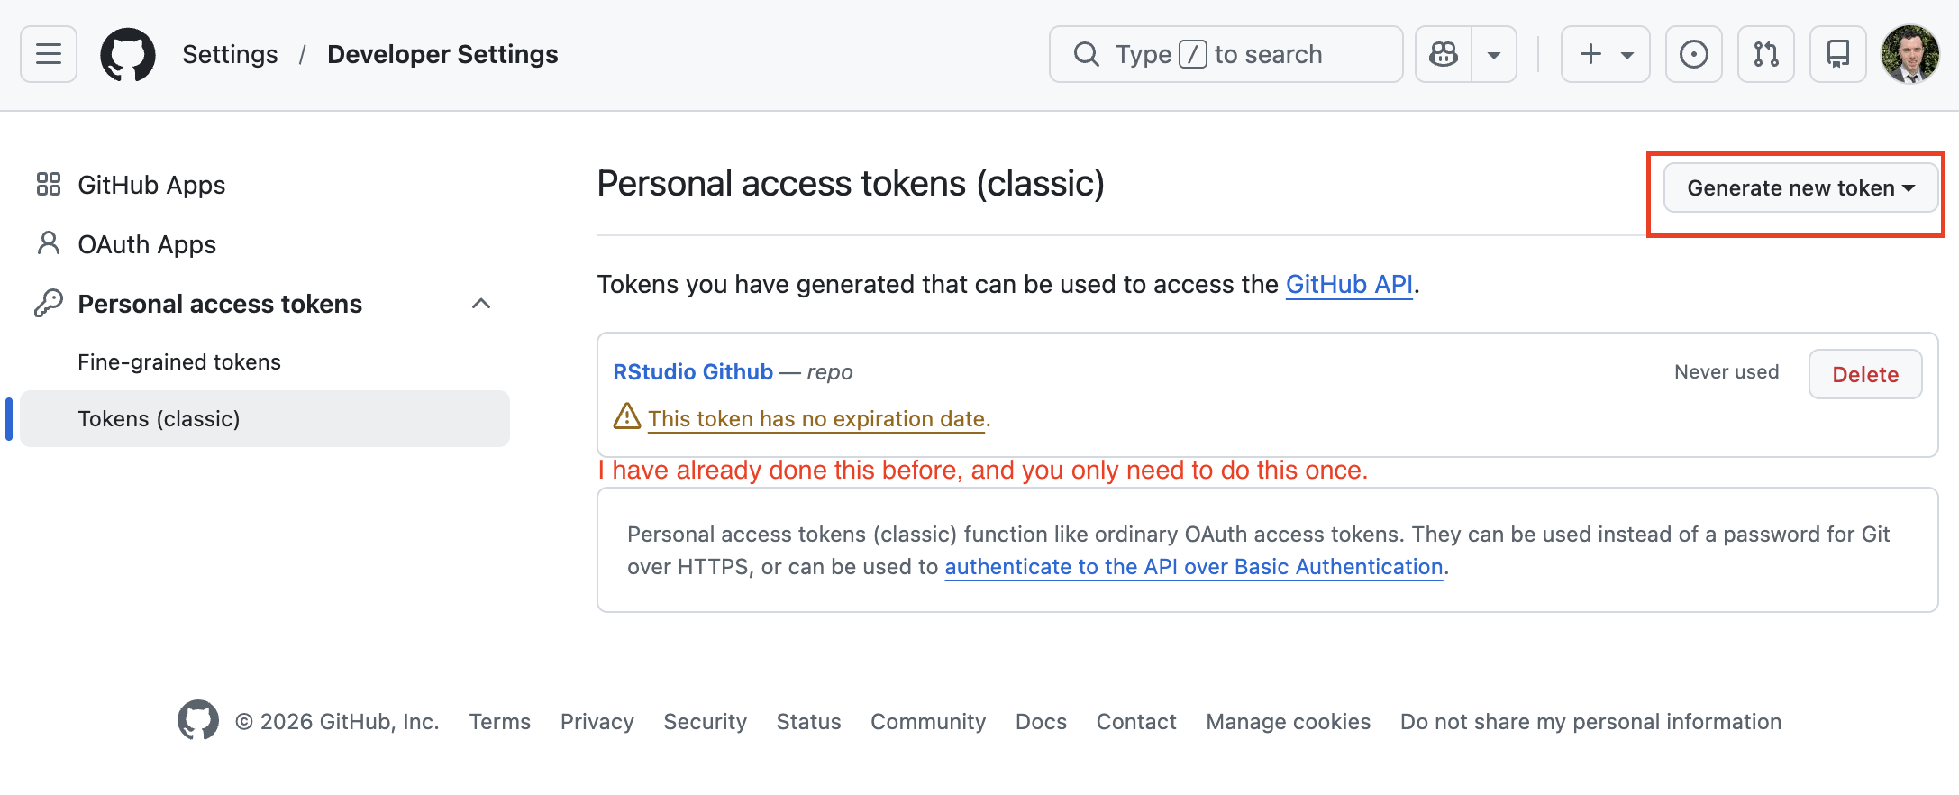
Causal Questions in Business
Creating & Connecting a GitHub Repo in RStudio

Slide 19
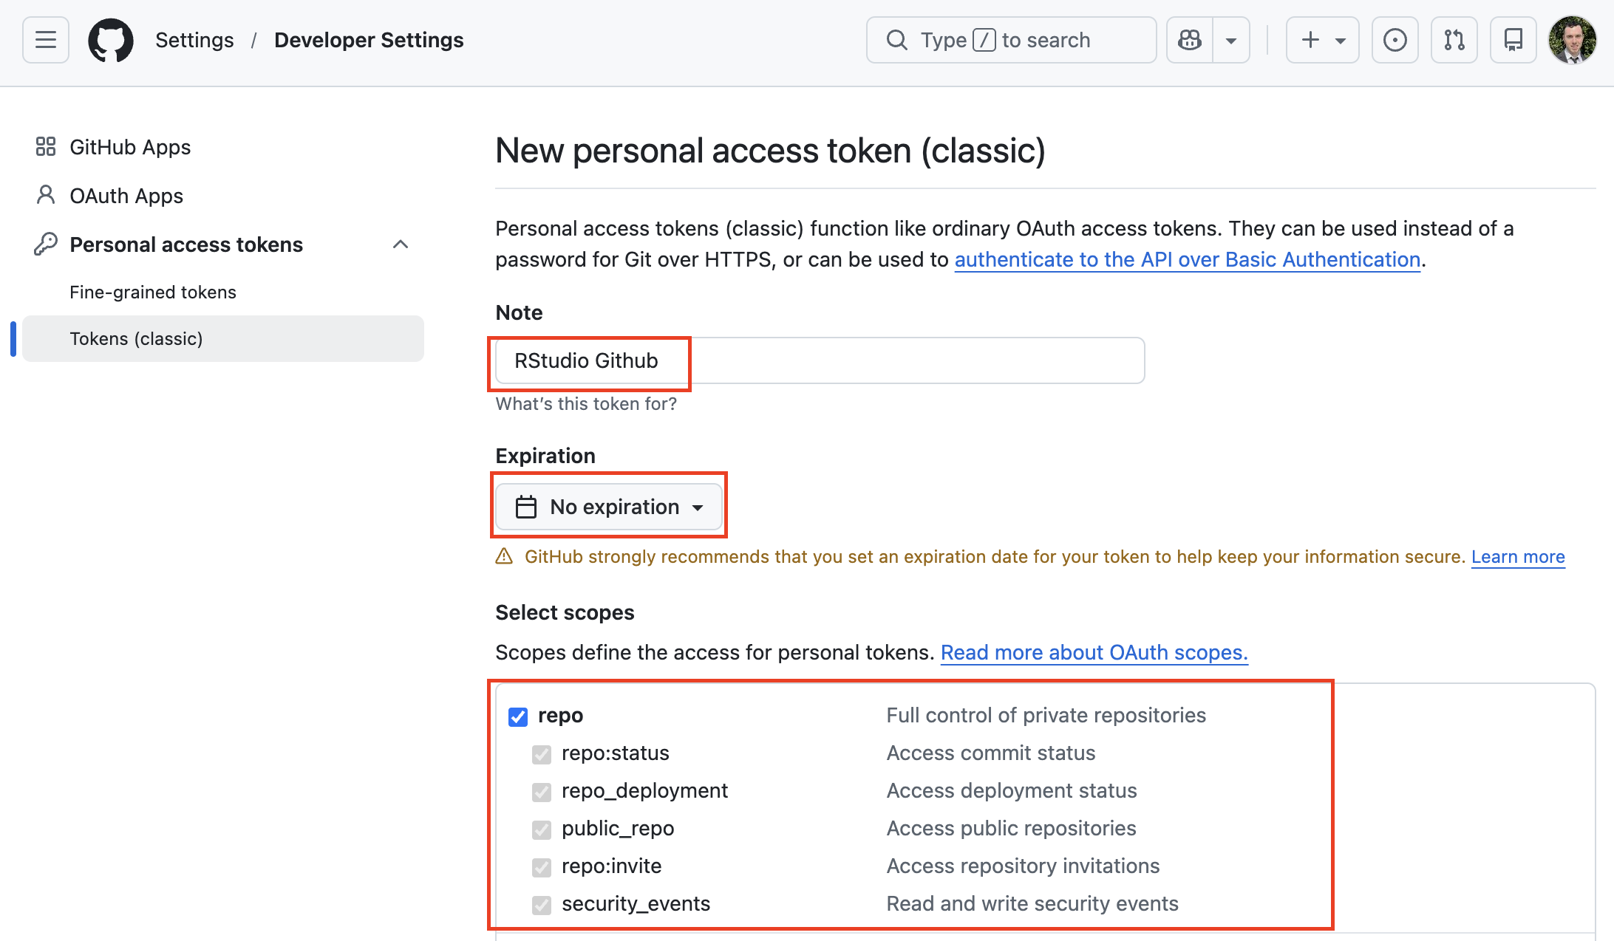
Causal Questions in Business
Creating & Connecting a GitHub Repo in RStudio
Make sure repo is selected!

Slide 20
Causal Questions in Business
Setting Up a Quarto Website
From GitHub Repository to Quarto Website
Connecting GitHub and RStudio
Previously, we connected a GitHub repository to RStudio.
This created a link between:
GitHub: online storage and version history
Git: tracks changes to files
RStudio: where we edit our files
Now we will add a Quarto website to this project.

Slide 21
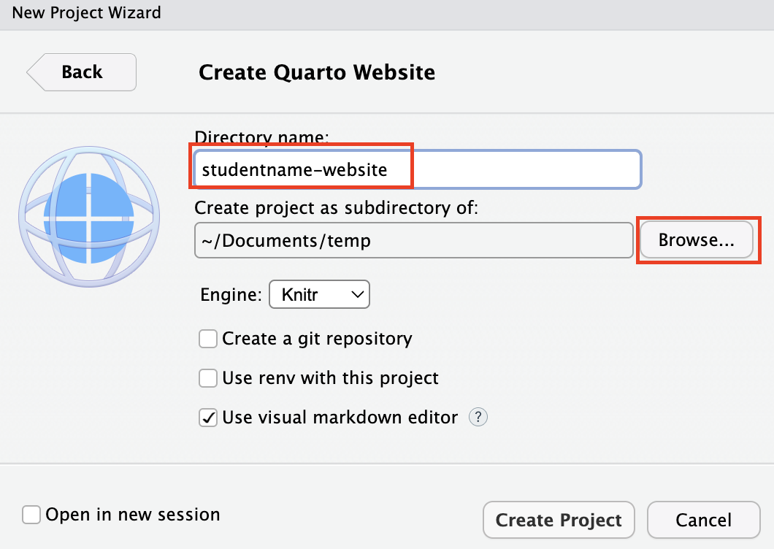
Causal Questions in Business
Setting Up a Quarto Website
In RStudio: Select File → New Project → New Directory → Quarto Website

Slide 22
Causal Questions in Business
Setting Up a Quarto Website
This creates:
my-website/
│
├── index.qmd
├── about.qmd
├── _quarto.yml
└── styles.css
The key file is:
_quarto.yml
This is the configuration file that tells Quarto:
this is a website
what the title is
what pages appear in the navigation bar
what theme/style to use

Slide 23
Causal Questions in Business
Setting Up a Quarto Website
The _quarto.yml File: Website Settings
Copy and Paste:
project:
type: website
output-dir: docs
website:
title: "Student Name"
navbar:
left:
- href: index.qmd
text: Home
- bio.qmd
- resume.qmd
- blog/index.qmd
page-footer:
center: |
© 2026 Student Name
left: |
![](/images/UniversityofPennsylvania_FullLogo_RGB.png){width=100px}
format:
html:
theme: flatly
css: styles.css
toc: false

Slide 24
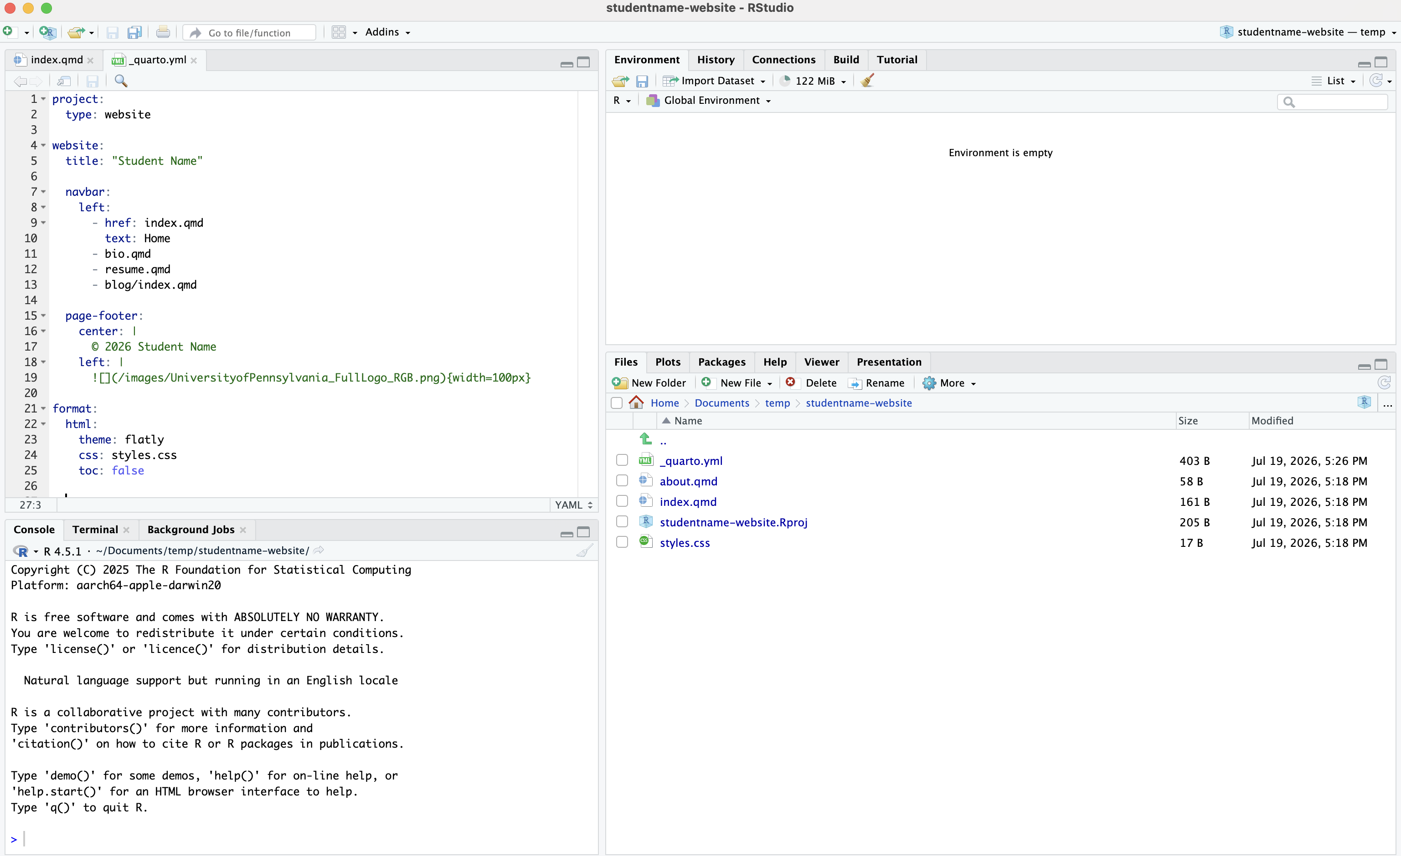
Causal Questions in Business
Setting Up a Quarto Website

Slide 25
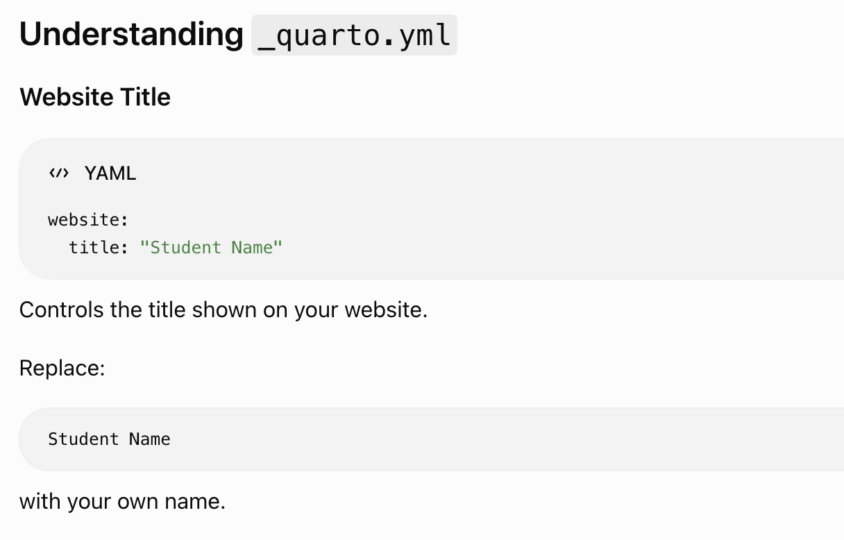
Causal Questions in Business
Setting Up a Quarto Website

Slide 26
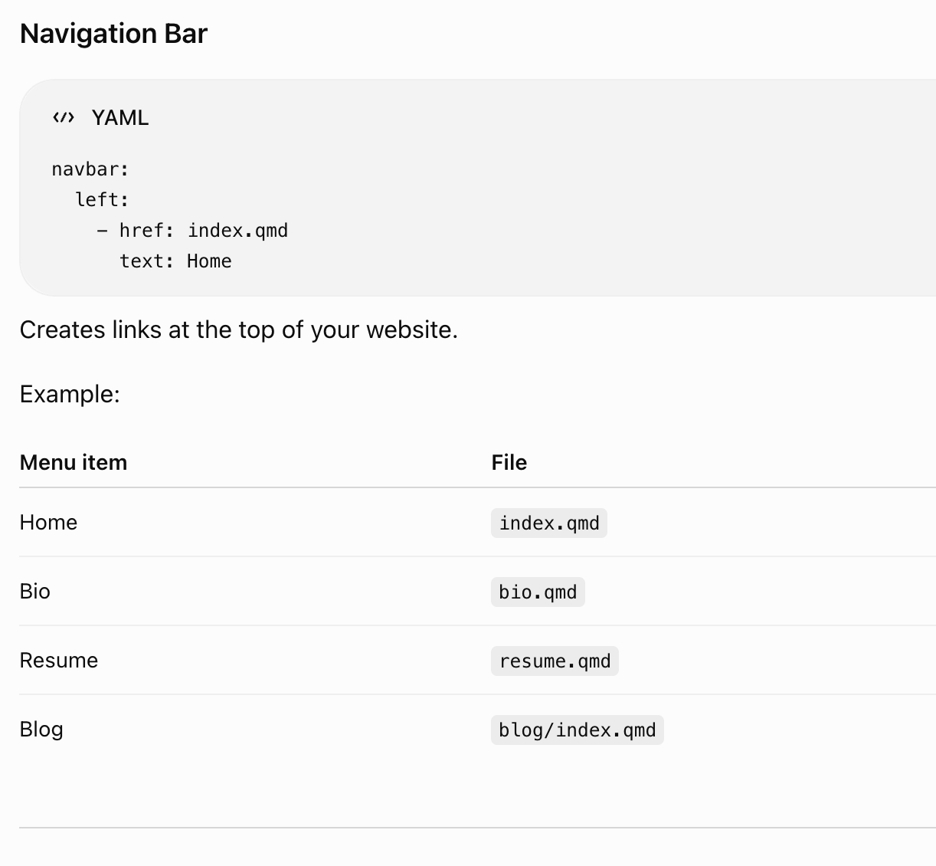
Causal Questions in Business
Setting Up a Quarto Website

Slide 27
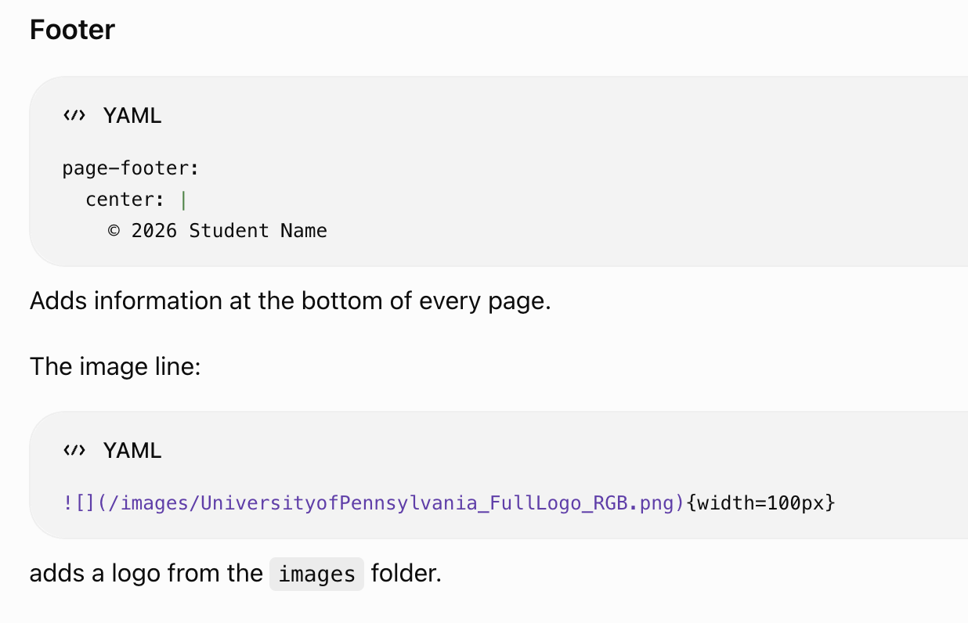
Causal Questions in Business
Setting Up a Quarto Website

Slide 28
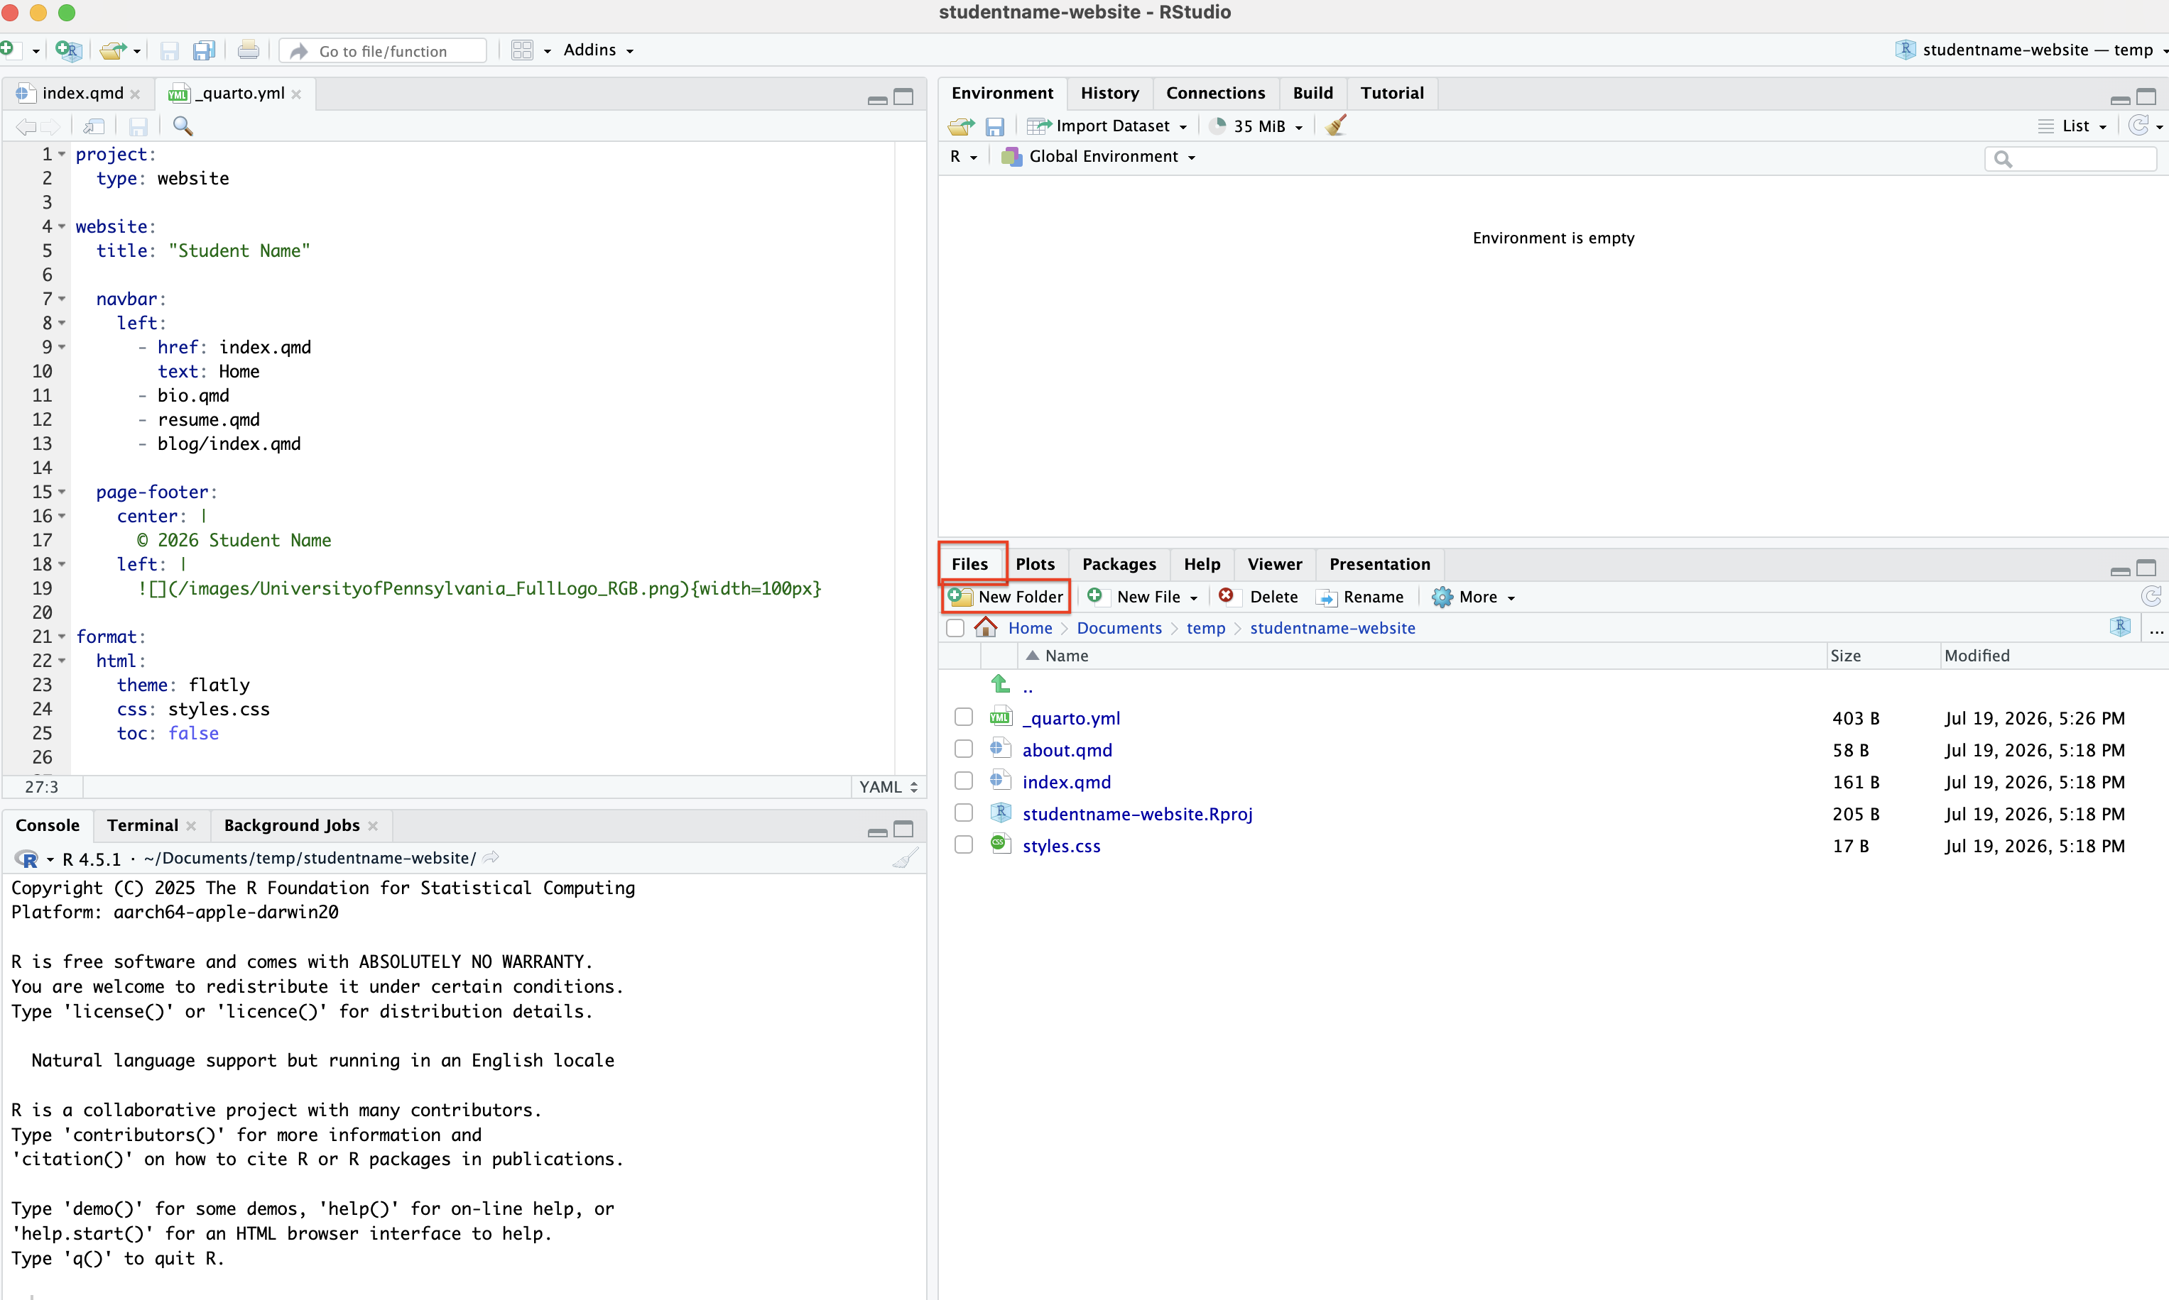
Causal Questions in Business
Setting Up a Quarto Website
Open the Files pane. Select New Folder. Name the folder images.
Place UniversityofPennsylvania_FullLogo_RGB.png in the images folder.

Slide 29
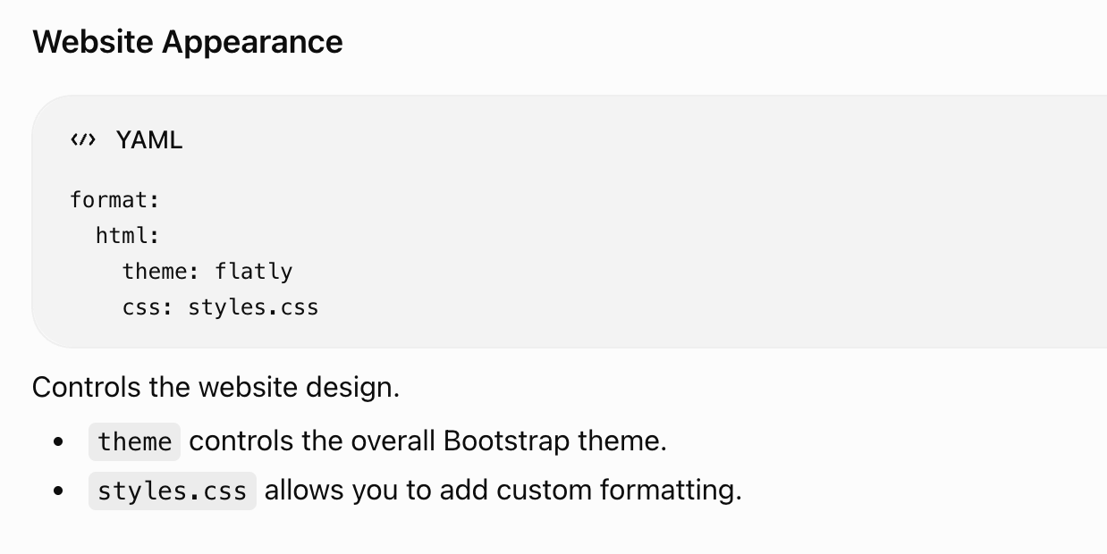
Causal Questions in Business
Setting Up a Quarto Website

Slide 30
Causal Questions in Business
Setting Up a Quarto Website
Next, in index.qmd copy and paste:
---
title: ""
---
::::: columns
::: {.column width="35%"}
![](images/profile.png){width="100%"}
:::
::: {.column width="65%"}
![](images/UniversityofPennsylvania_FullLogo_RGB.png){width="250px"}
# Student Name
University of Pennsylvaina
Welcome to my personal website.
### Quick Links
<div>
<a href="https://github.com/USERNAME"><i class="bi bi-github fs-3"></i></a>
<a href="https://linkedin.com/in/USERNAME"><i class="bi bi-linkedin fs-3"></i></a>
<a href="resume.qmd"><i class="bi bi-file-earmark-person-fill fs-3"></i></a>
<a href="mailto:student@email.com"><i class="bi bi-envelope-fill fs-3"></i></a>
</div>
:::
:::::

Slide 31
Causal Questions in Business
Setting Up a Quarto Website

Slide 32
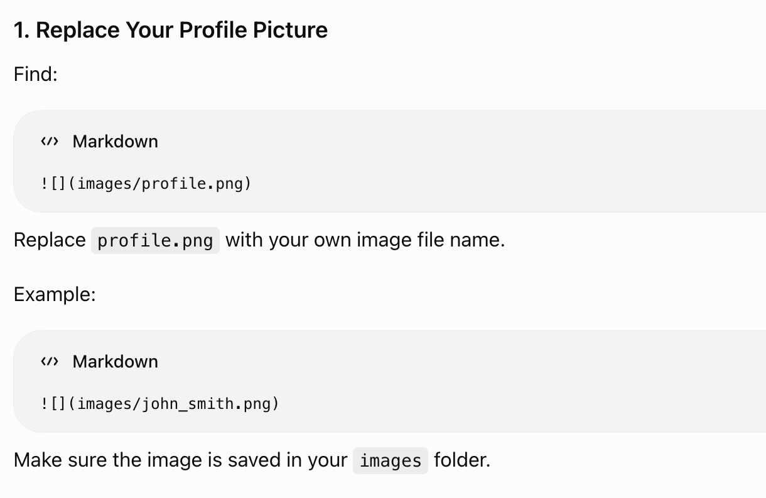
Causal Questions in Business
Setting Up a Quarto Website

Slide 33
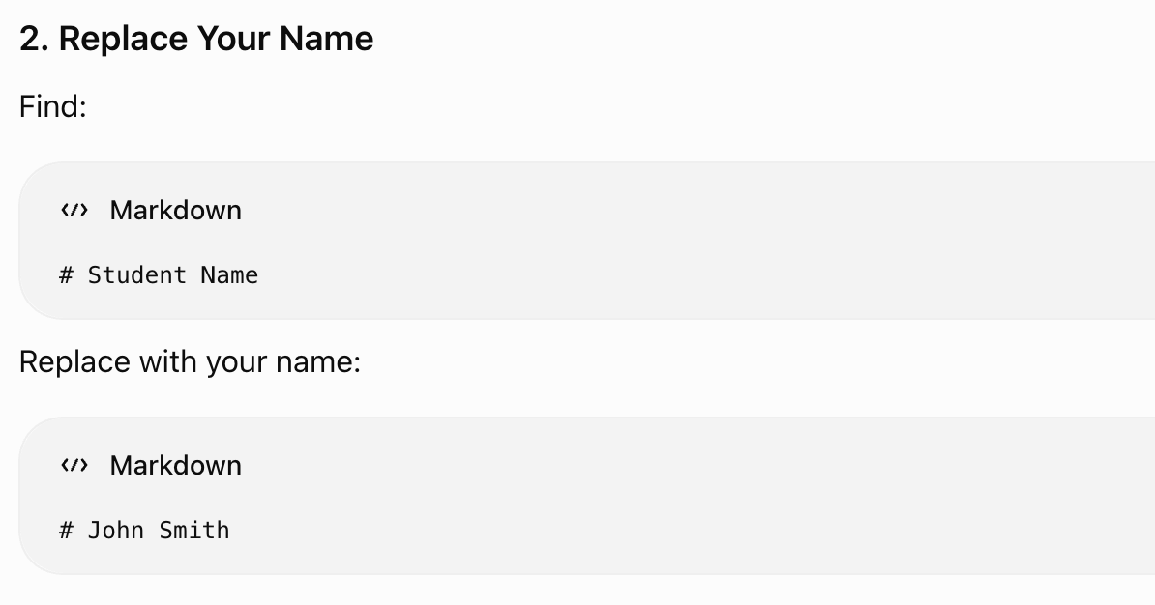
Causal Questions in Business
Setting Up a Quarto Website

Slide 34
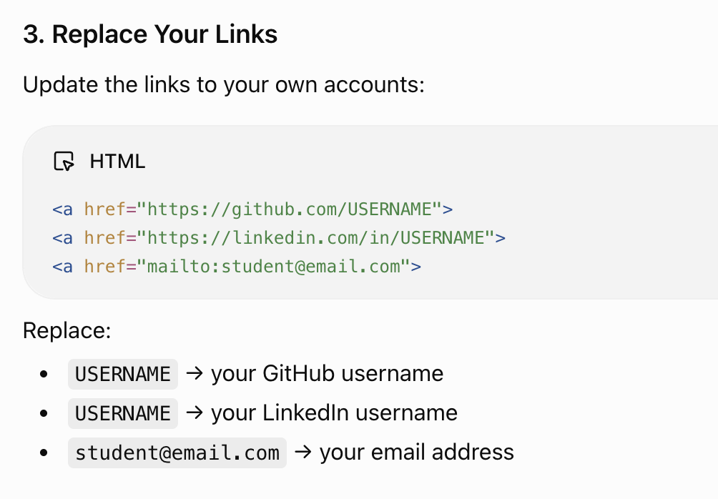
Causal Questions in Business
Setting Up a Quarto Website

Slide 35
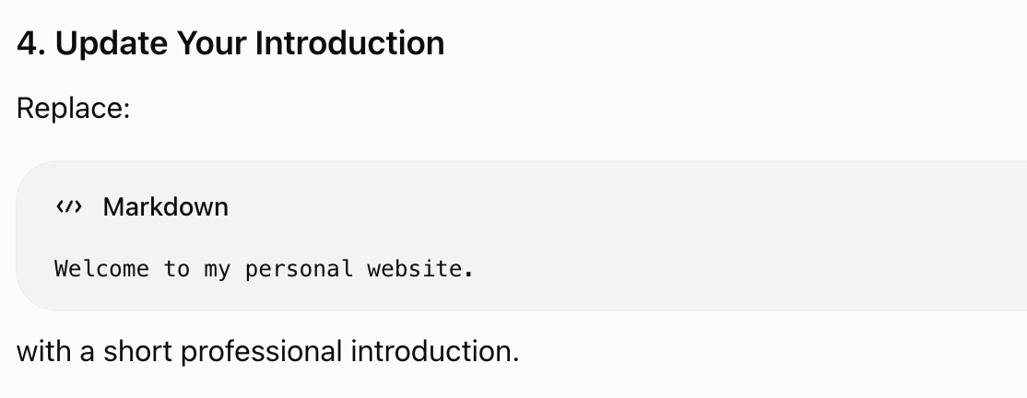
Causal Questions in Business
Setting Up a Quarto Website

Slide 36
Causal Questions in Business
Setting Up a Quarto Website
Open styles.css in the files tab and copy and paste:
body {
max-width: 1000px;
margin: auto;
}
p {
line-height: 1.6;
}
.navbar {
font-size: 1.05rem;
}
h1 {
margin-top: 0.5em;
}

Slide 37
Causal Questions in Business
Setting Up a Quarto Website
Create bio.qmd (File → New File → Quarto Document) and copy and paste with appropriate personalization:
---
title: "About Me"
---
Write a short biography here.
Include:
- Educational background
- Professional interests
- Technical skills
- Career goals
## Education
Master of Applied Economics and Data Science, University of Pennsylvania (expaceted 2027) Batelor of Science, University Name 2026
## Interests
- Econometrics
- Machine Learning
- Data Analysis
## Contact
## student\@email.edu

Slide 38
Causal Questions in Business
Setting Up a Quarto Website
Create resume.qmd (File → New File → Quarto Document) and copy and paste with appropriate personalization:
---
---
title: "Resume"
---
Download my resume here:
## [Resume PDF](files/Resume.pdf)
Create a new file called files and put your resume in it

Slide 39
Causal Questions in Business
Setting Up a Quarto Website
Create a new folder called blog. Inside the folder, create index.qmd with:
---
title: "Blog"
listing:
contents: posts
sort: "date desc"
type: default
---
Still inside the blog folder, create another folder called posts. Inside the posts folder, create 2 more folders called post1 and post 2.

Slide 40
Causal Questions in Business
Setting Up a Quarto Website
Inside the post1 folder: place the figure1.png file and create a file called index.qmd with:
---
title: "My First Blog Post"
date: 2026-06-16
categories:
- personal
- data-science
---
![](figure1.png){width="500px"}
This is my first blog post. Example $\LaTeX$ equation: $\frac{1}{2}\sum_{i=1}^nx_i$

Slide 41
Causal Questions in Business
Setting Up a Quarto Website
Inside the post2 folder: create a file called index.qmd with:
---
title: "My Second Blog Post"
date: 2026-06-16
categories:
- opinion
- labor market
---
This is my second blog post.

Slide 42
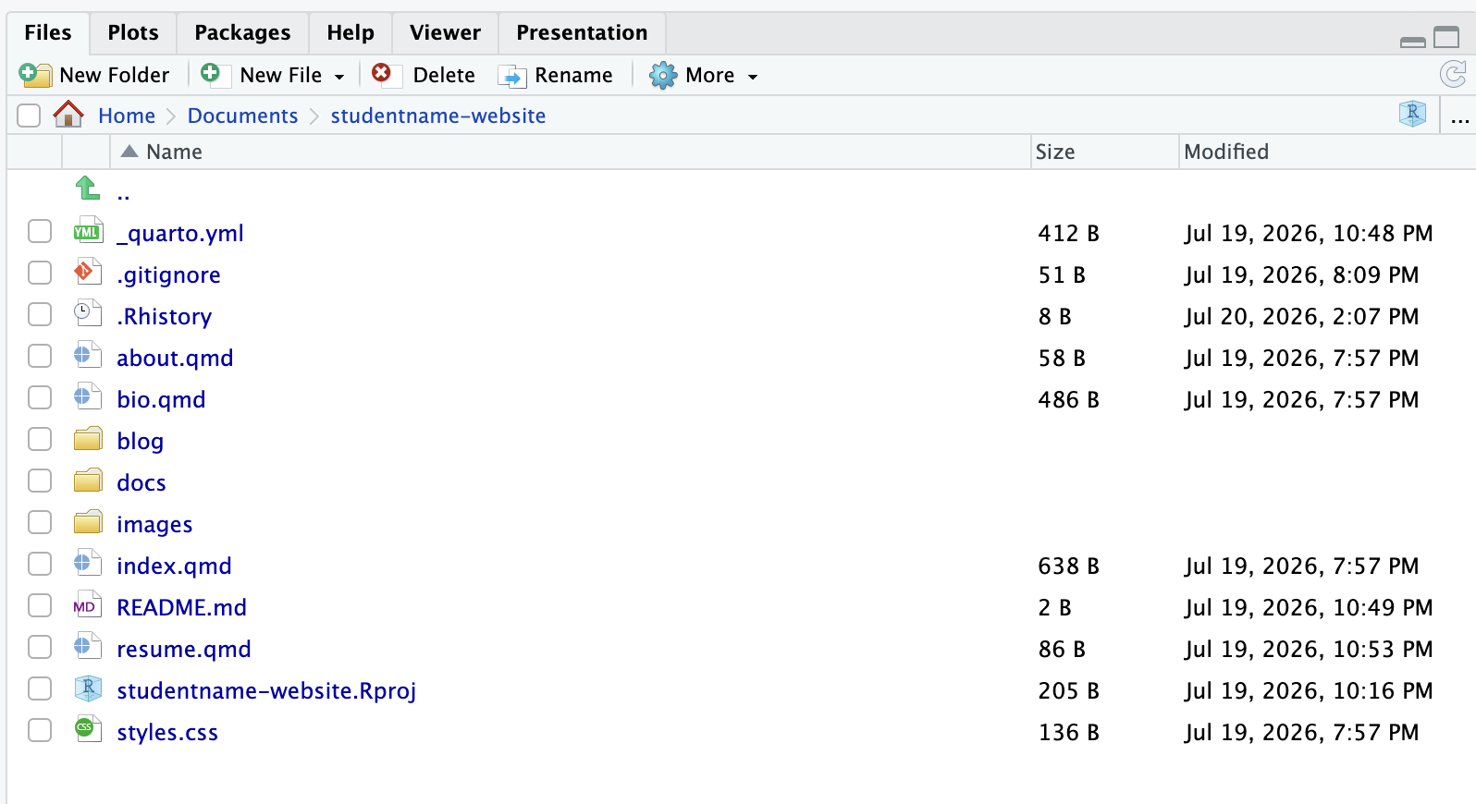
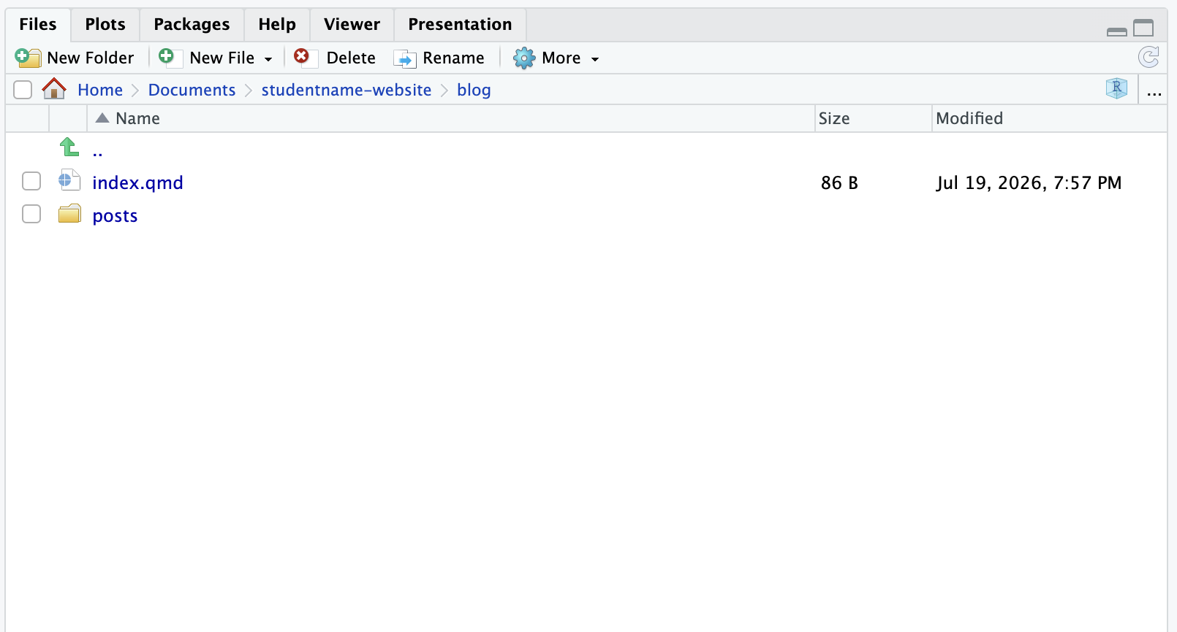
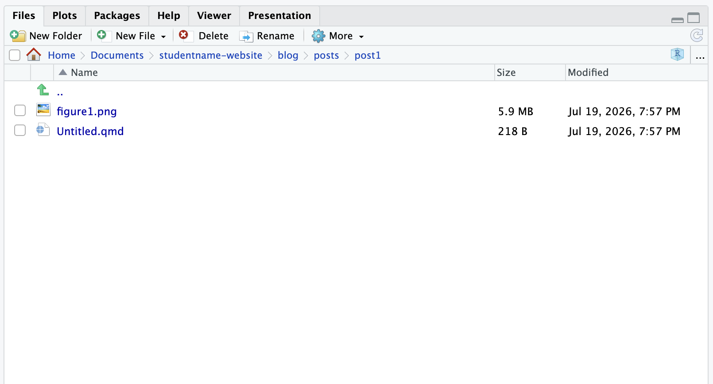
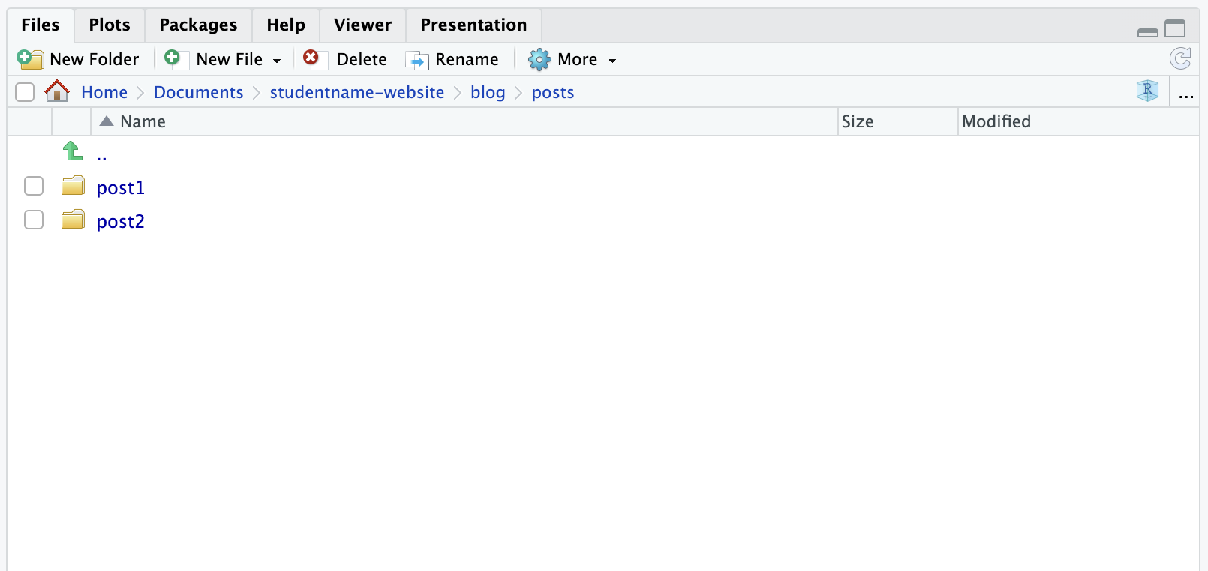
Causal Questions in Business
Setting Up a Quarto Website
Your files path should look like:

Slide 43
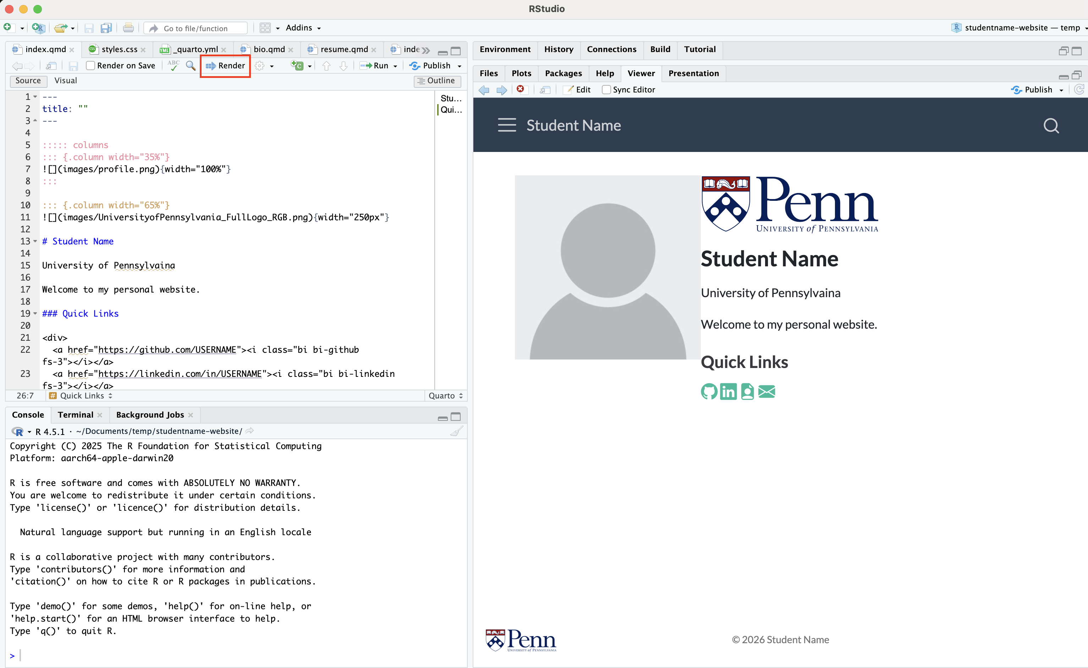
Causal Questions in Business
Setting Up a Quarto Website
Now click Render

Slide 44
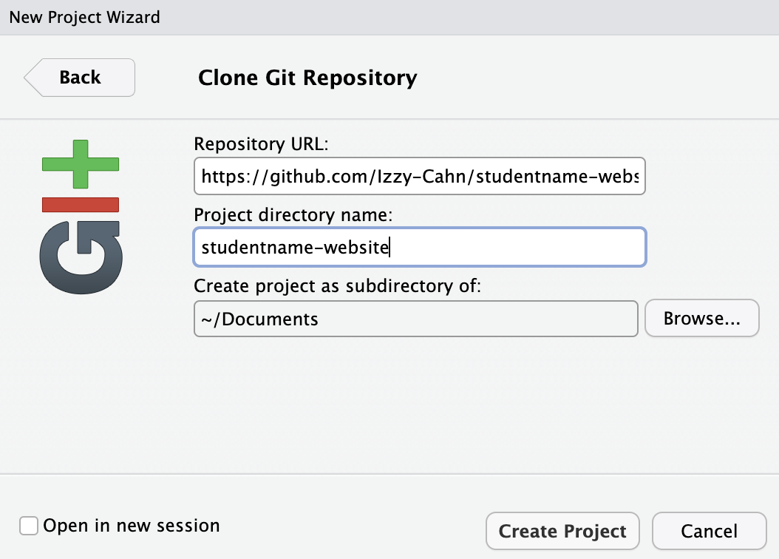
Causal Questions in Business
Setting Up a Quarto Website
File → New Project → Version Control → Git (copy and paste the GitHub url) and call the directory website

Slide 45
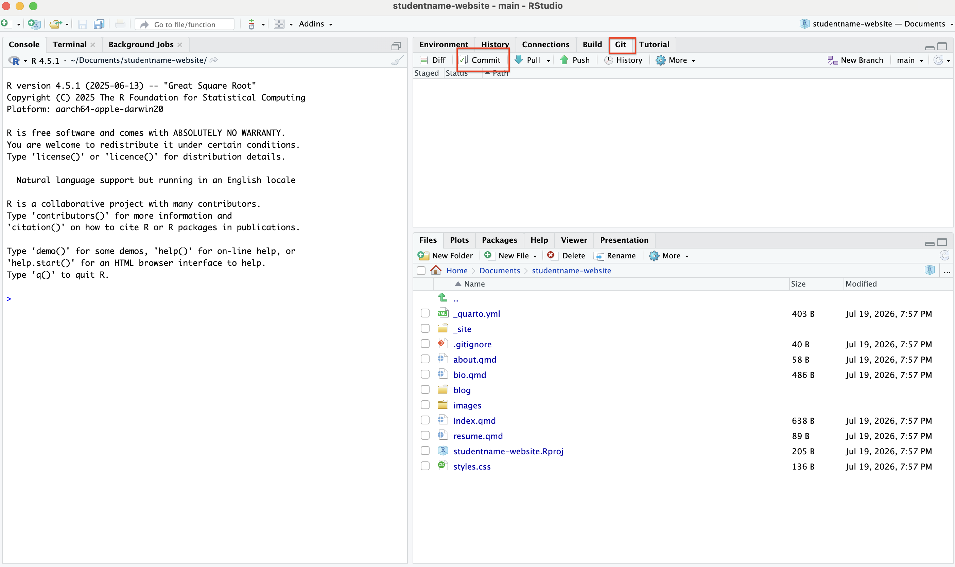
Causal Questions in Business
Setting Up a Quarto Website
Commit and Push Your Changes

Slide 46
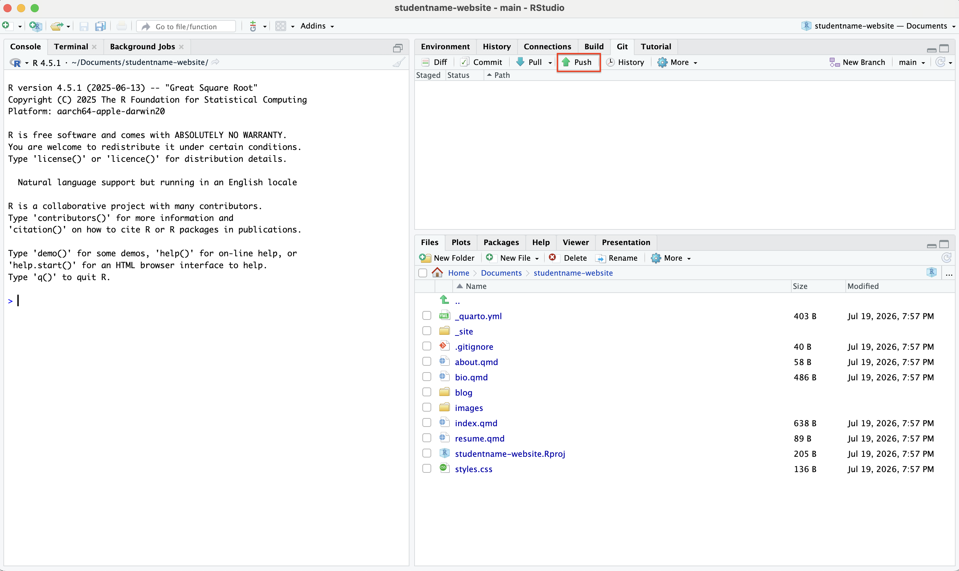
Causal Questions in Business
Setting Up a Quarto Website
Commit and Push Your Changes

Slide 47
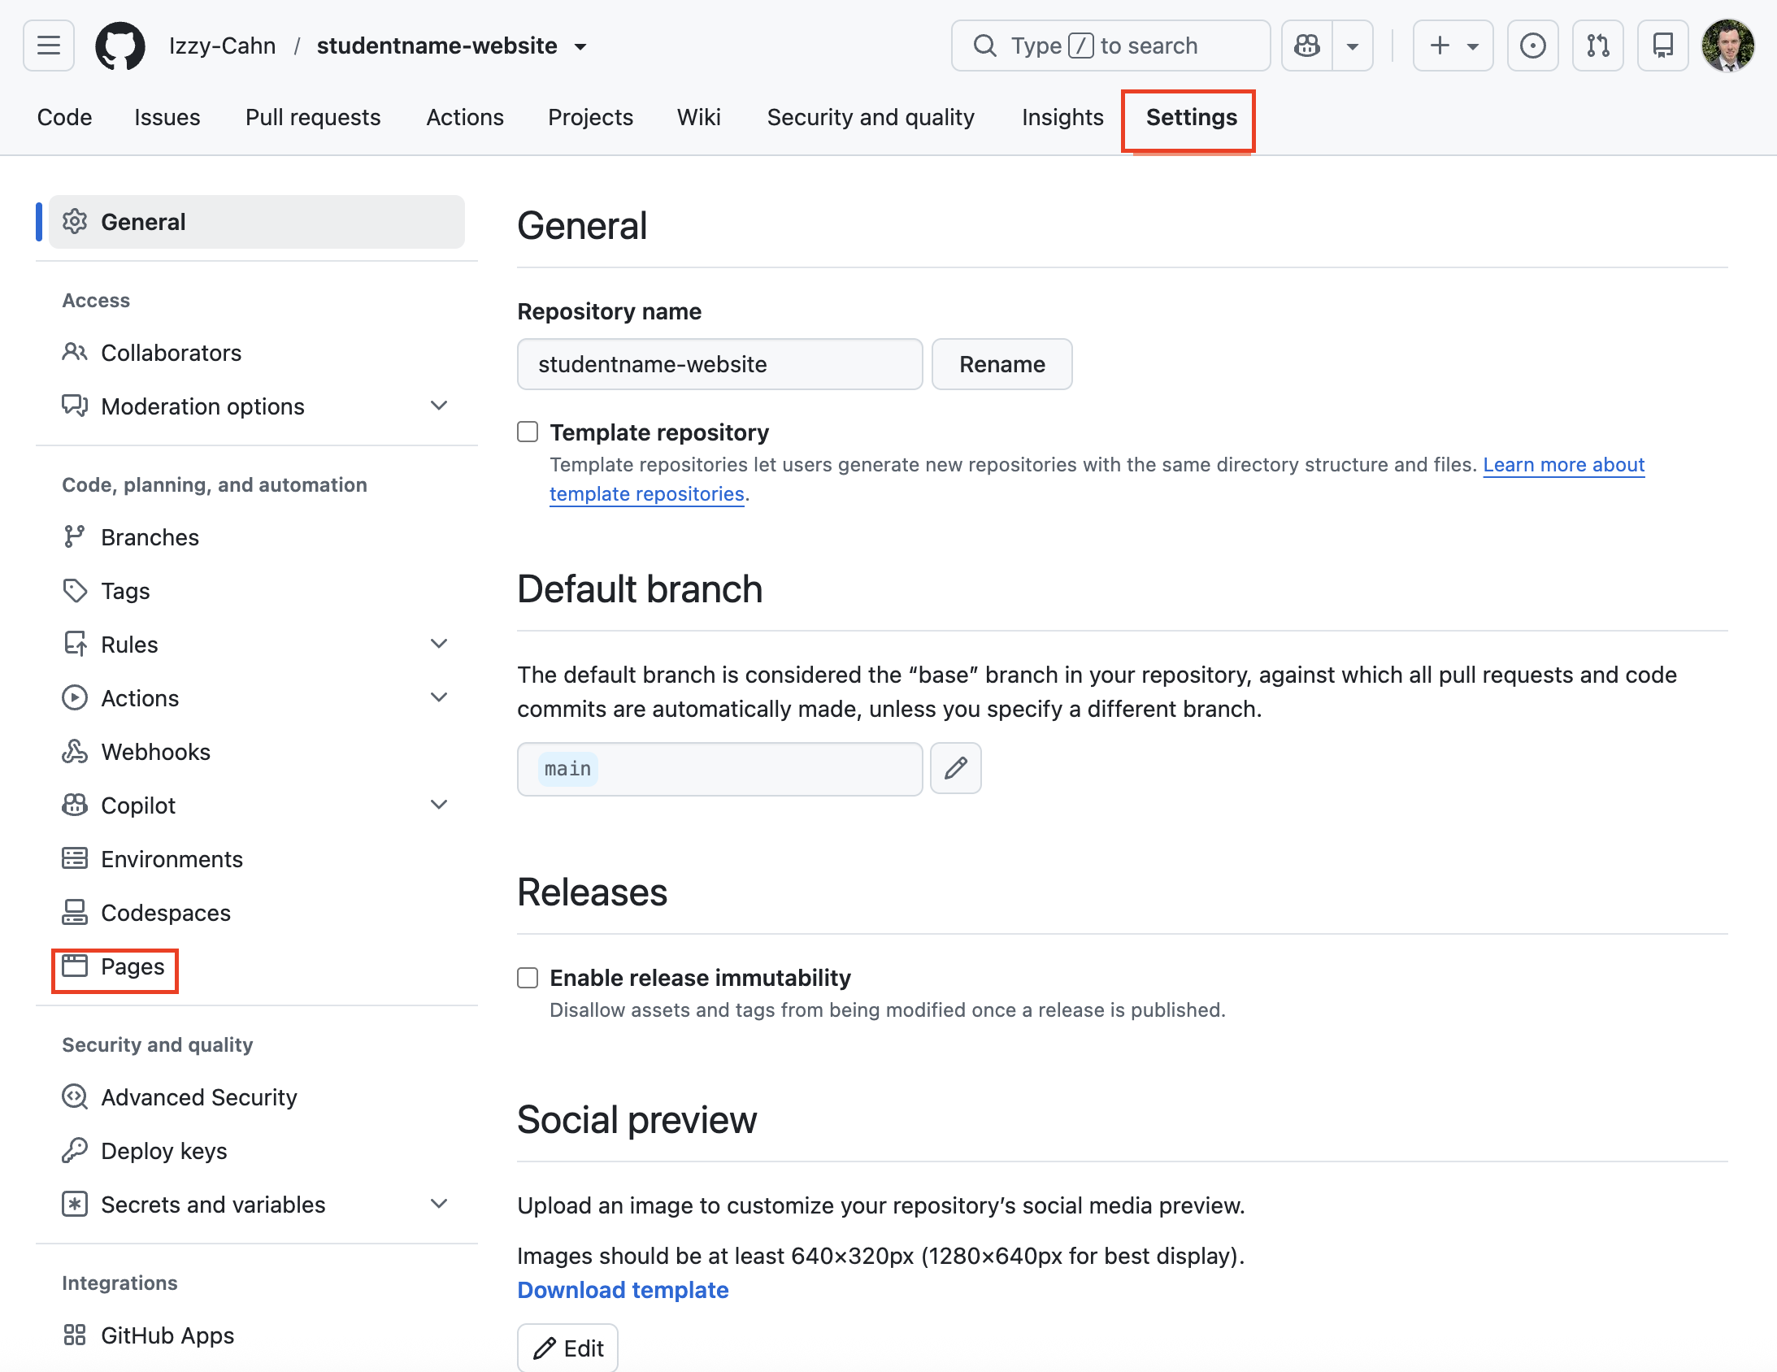
Causal Questions in Business
Setting Up a Quarto Website

Slide 48
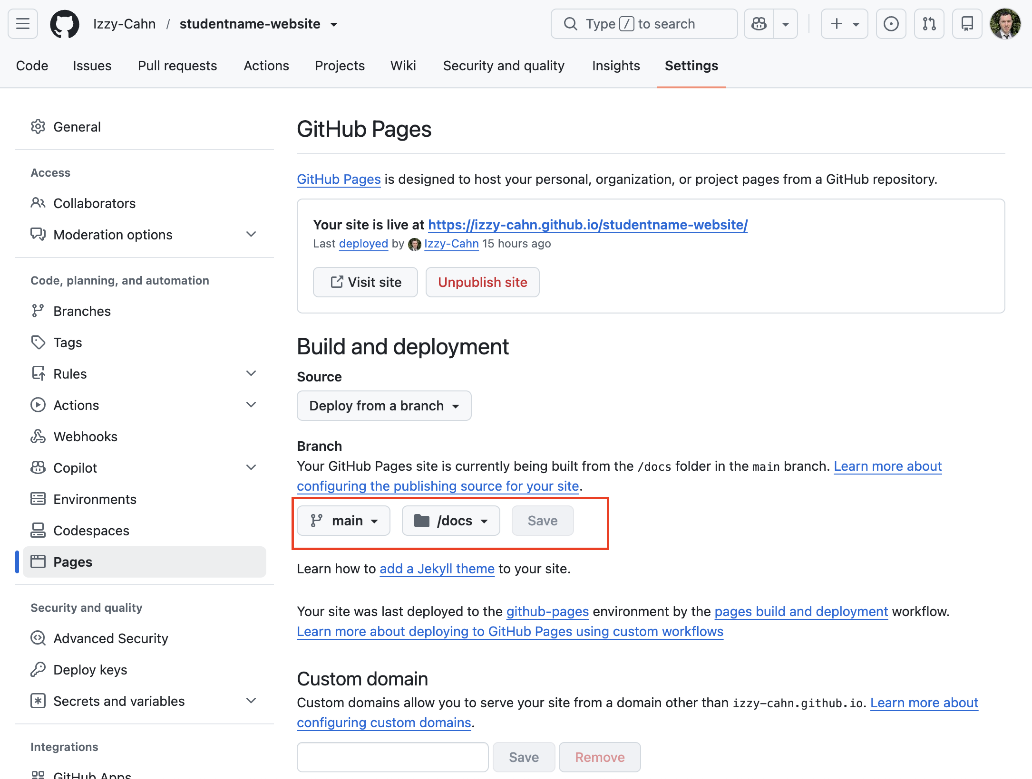
Causal Questions in Business
Setting Up a Quarto Website

Slide 49
Causal Questions in Business
Homework 0
Put together a resume
Add a profile photo and bio

